Slide 1

HAS January 2023 Photo Contest
Participants and Winners

Slide 2
HAS January 2023 Photo Participants
Photographer | Category | Bird | Location
Alison Wilcox | Bird Behavior Rarest Bird Rarest Bird Funniest | Red Tailed Hawk Kestrel Snow Goose Canada Goose | South Windsor East Windsor Avon East Windsor
Annette Pasek | Best Overall Bird Behavior Rarest Bird OOPS Funniest | Duck Ring-billed Gull Oriole Monk Parakeet Bottoms Up | East Hartford Charter Oak Landing/Hartford East Harford New Britain Pitkin Pond, East Hartford
Barbara Scavotto | Best Overall Rarest Bird Bird Behavior Funniest | Bald Eagle hunting Monk Parakeet Female Hairy Woodpecker Bald Eagle yawning | Union Pond, Manchester Willow Brook Park, New Britain Union Pond, Manchester Union Pond, Manchester
Donna Summers | Bird Behavior OOPS | Bald Eagle Bald Eagle Fly off | Nod Brook, WMA, Avon Nod Brook, WMA, Avon
Doug Murray | Best Overall | Cardinal | Bloomfield
Sophia Marler | Best Overall OOPS | Barred Owl Barred Owl - Yawning | Glastonbury Glastonbury

Slide 3
HAS January 2023 Photo Participants
Photographer | Category | Bird | Location
Joan Heffernan | Best Overall Bird Behavior Birders OOPS Funniest | Cooper’s Hawk Robin Housekeeping Raven, Crow? Swans – Bottom Up | Suffield Windsor Locks Union Pond, Manchester Riverfront Park, Glastonbury Batterson Park, Farmington
Maggie Peretto | Rarest Bird | Oregon Junco | Rosedale Farm, Simsbury
Martin Kaehrle | Best Overall | Gull Yawning | Charter Oak Landing – Hartford
Sarah Faulkner | Bird Behavior OOPS | Cardinal Red-Tailed Hawk | Simsbury Farmington
Virge Kask | Best Overall Bird Behavior | Cardinal Eastern Bluebird | Spice Bush Park, West Hartford Dismal Brook, Granby
Glenn Burger | Best Overall Bird Behavior | Black Vultures Bald Eagles | Canton Farmington

Slide 4
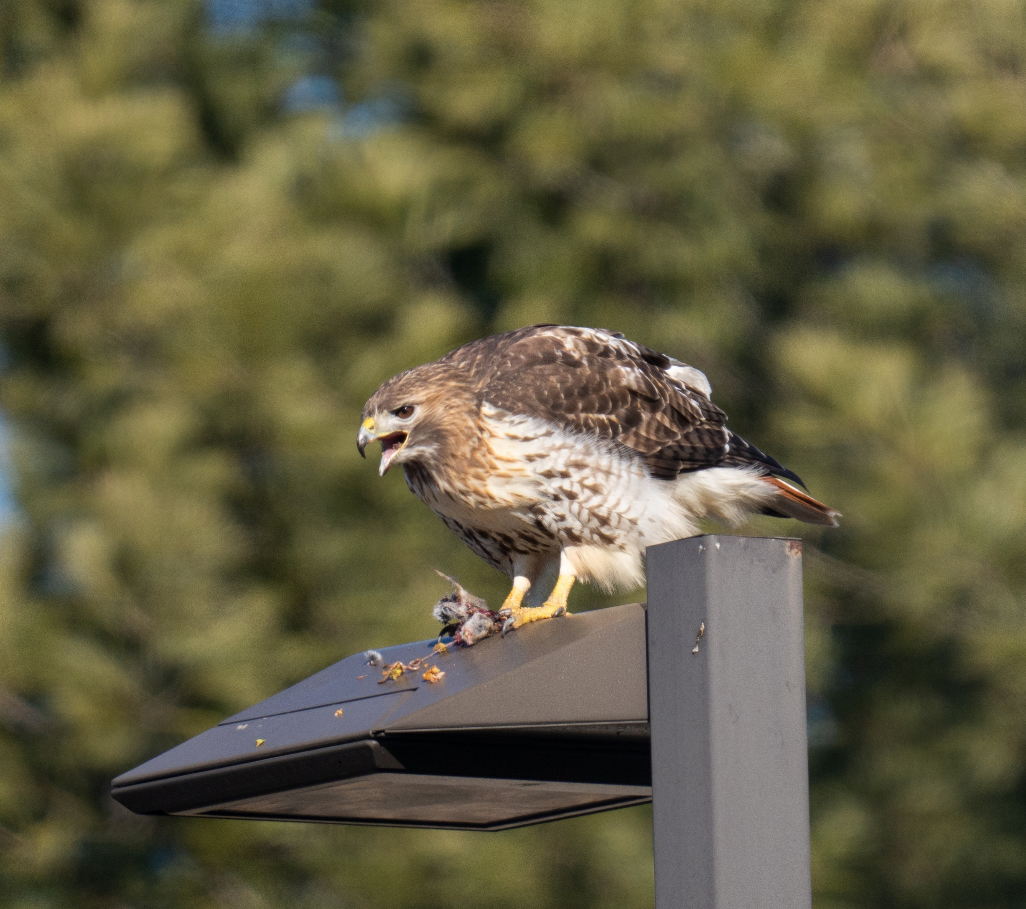
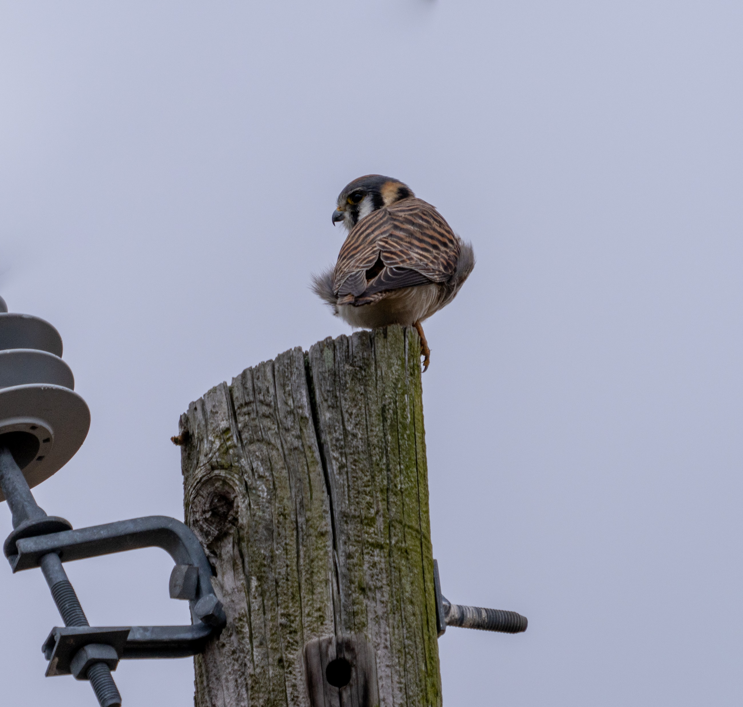
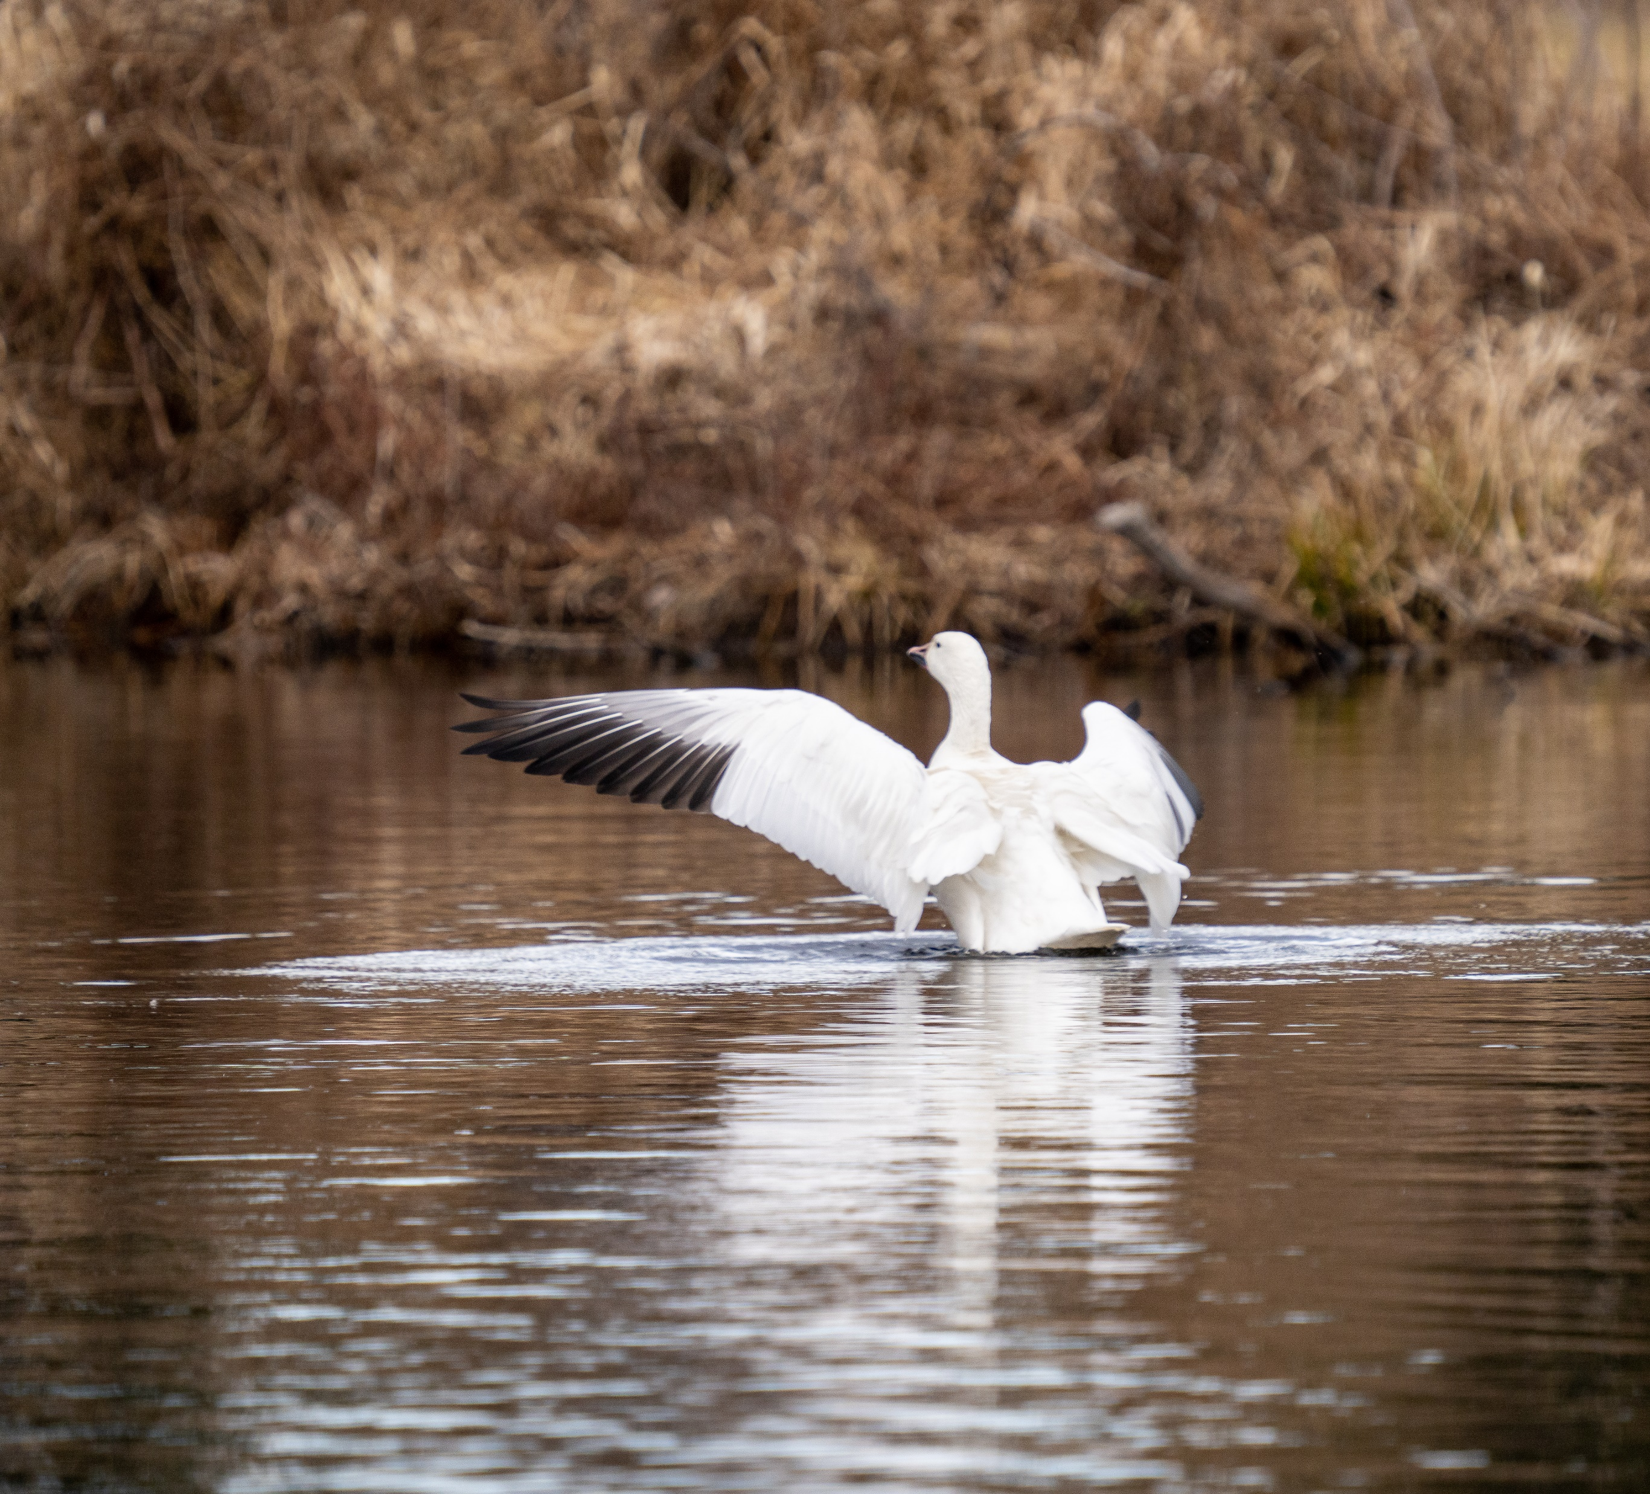
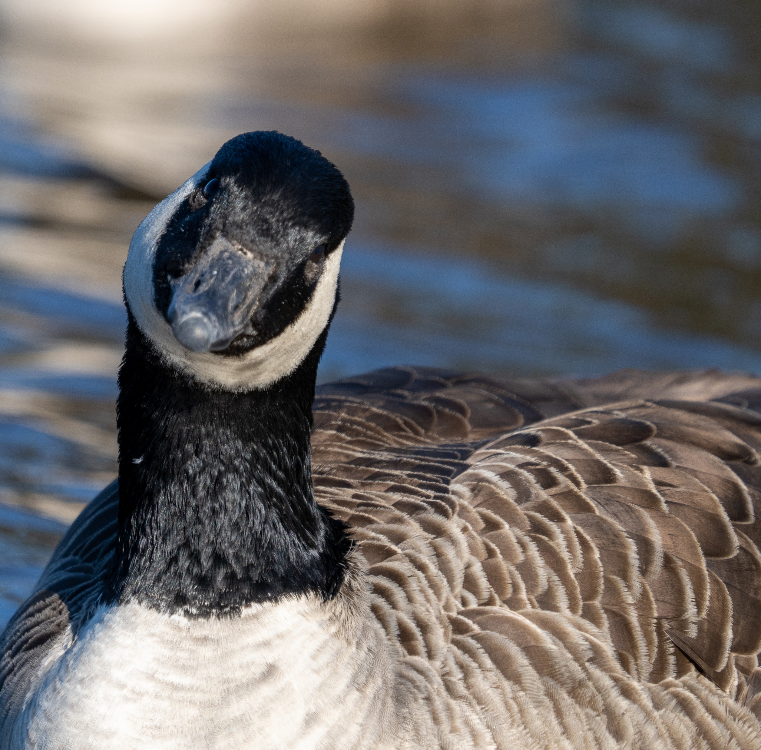
Alison Wilcox Photos

Slide 5
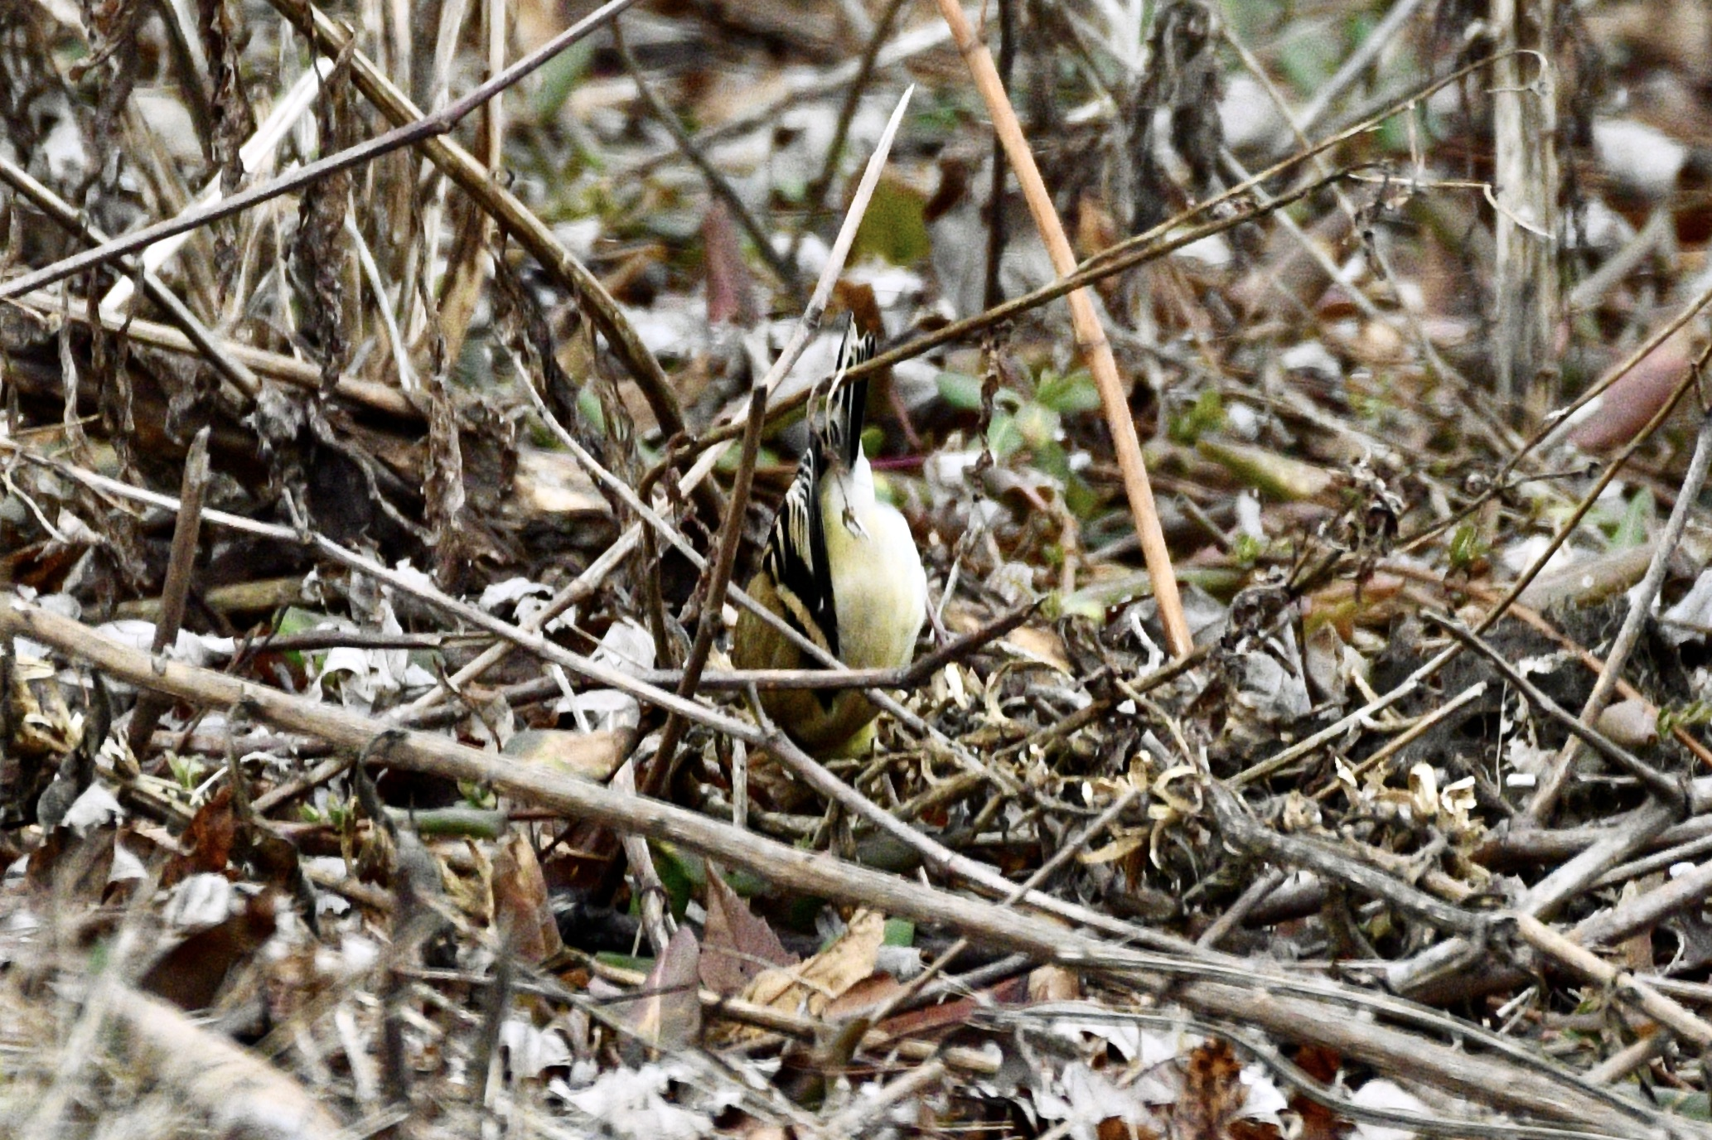
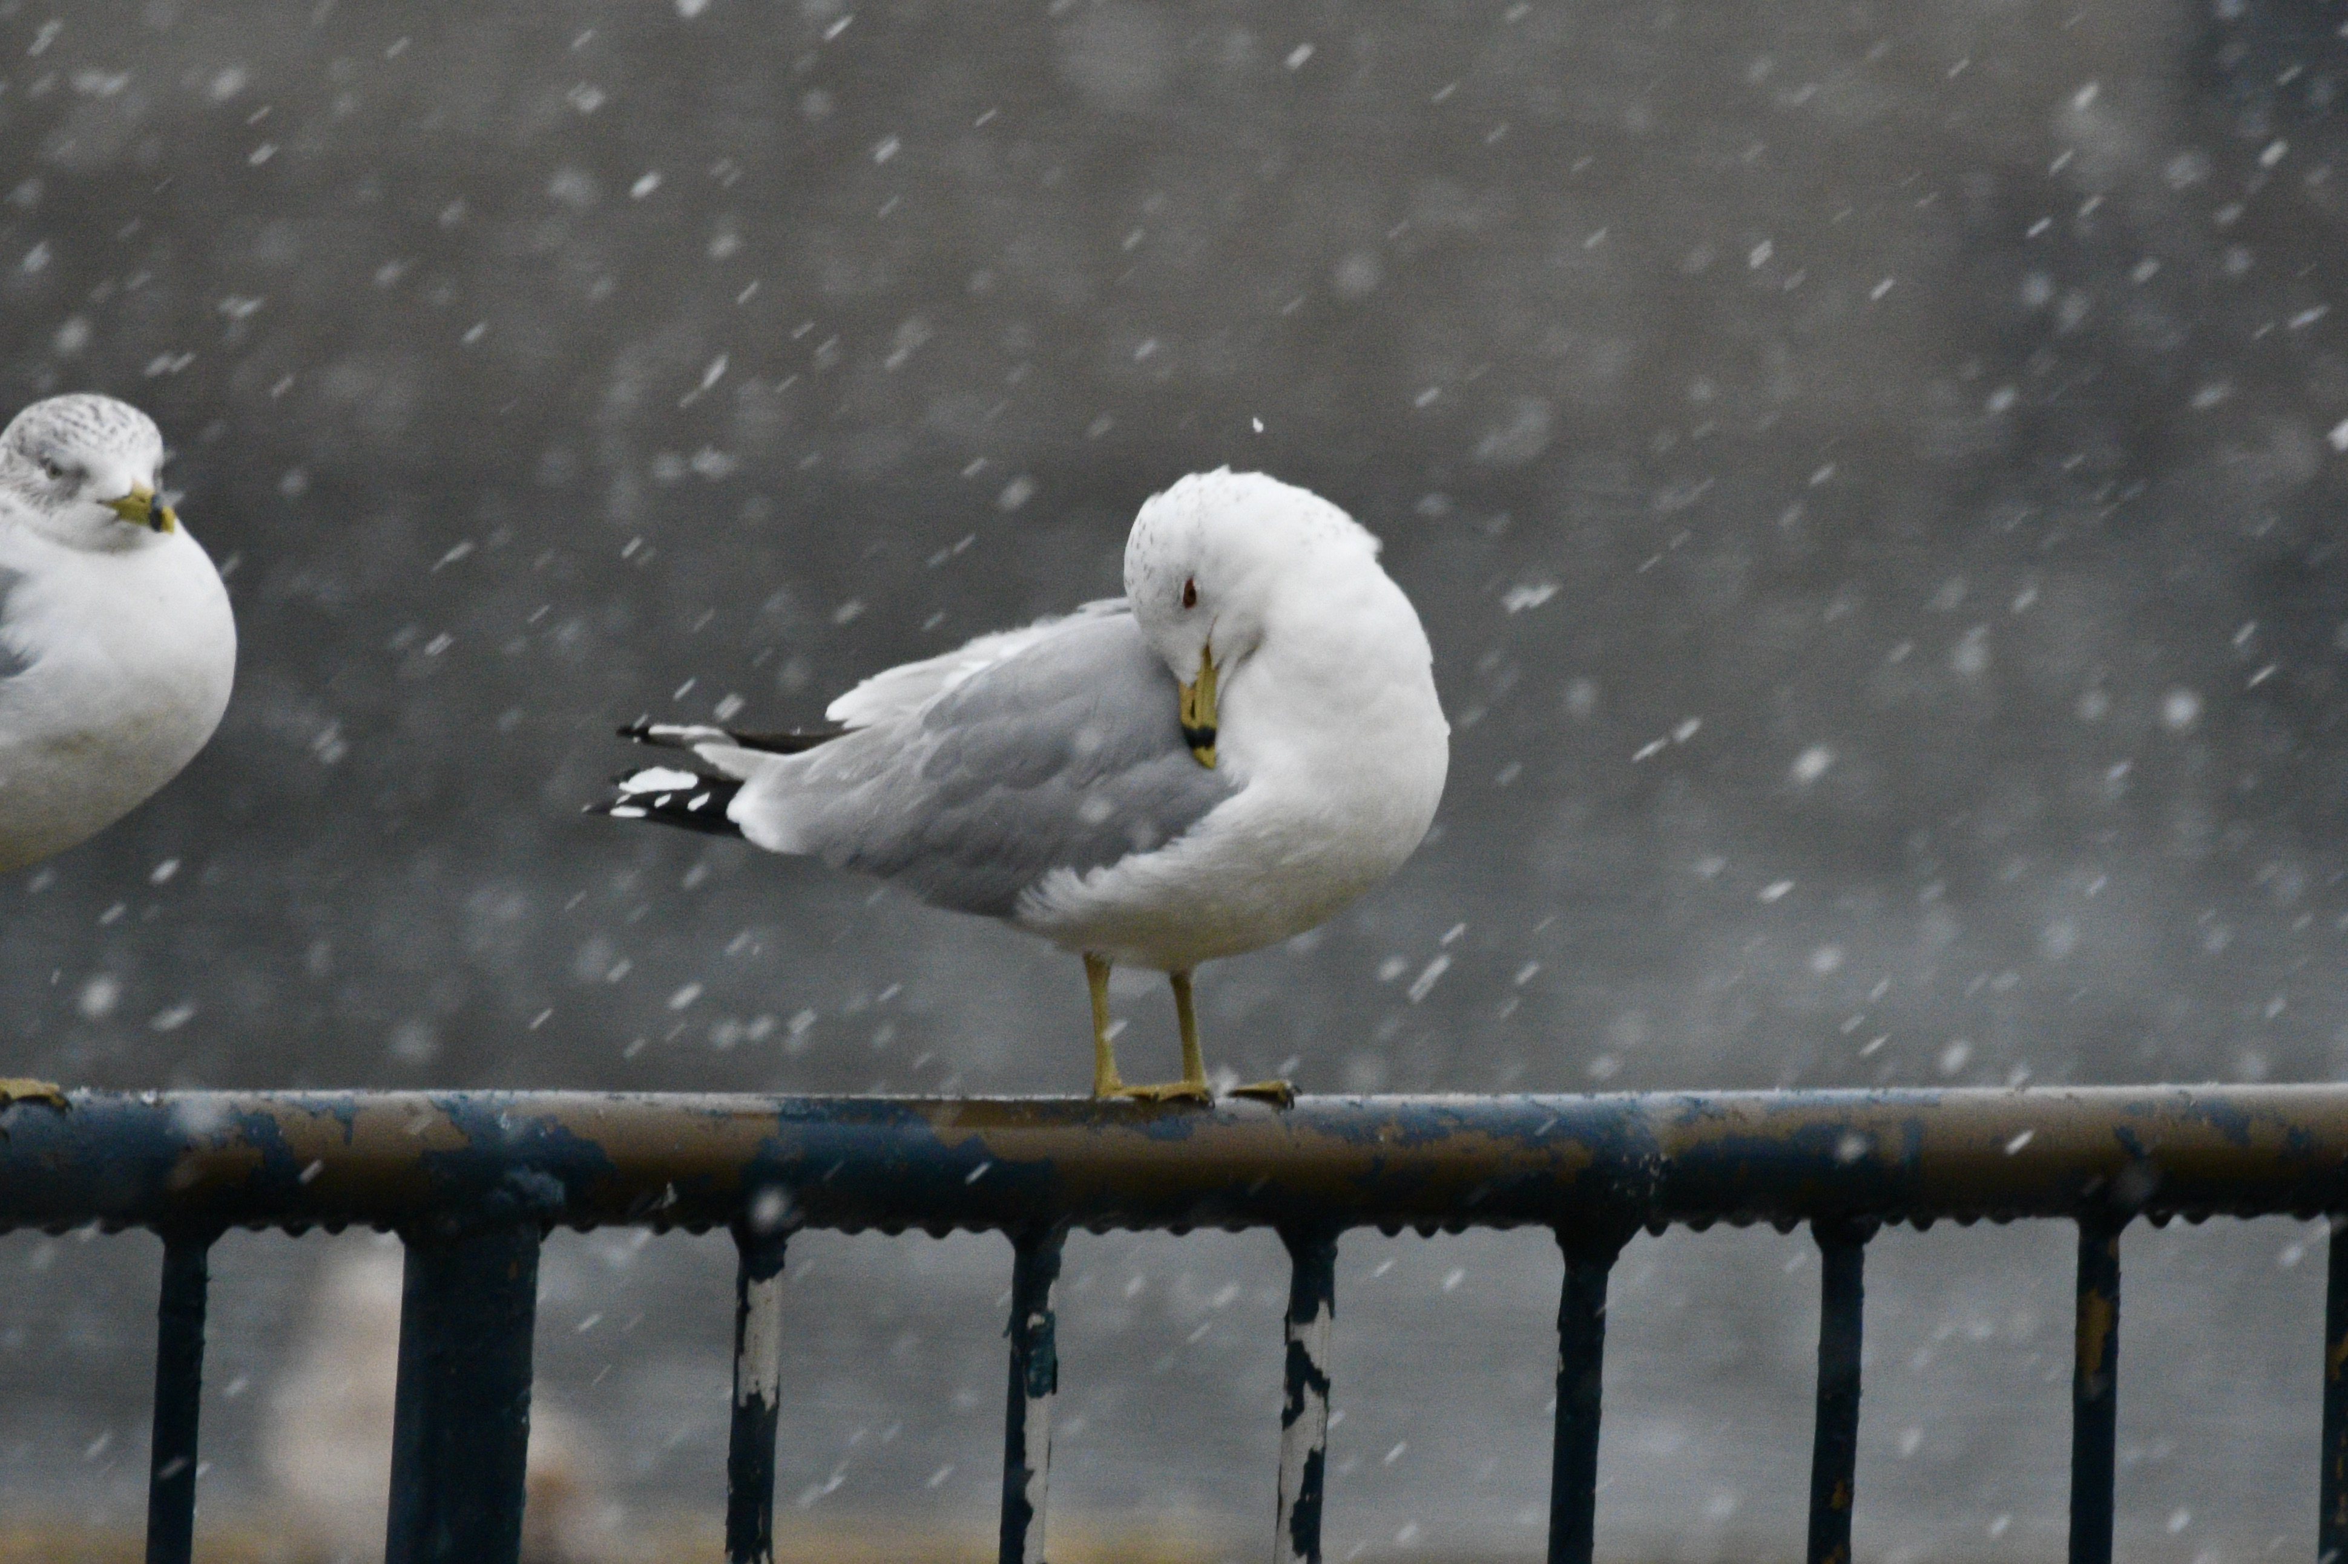
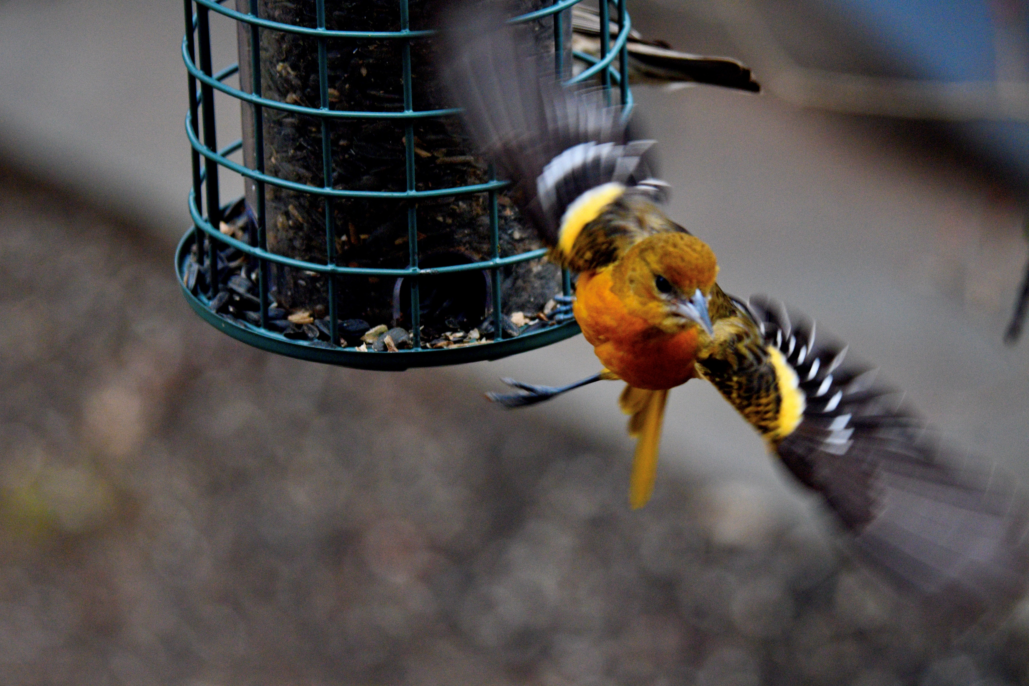
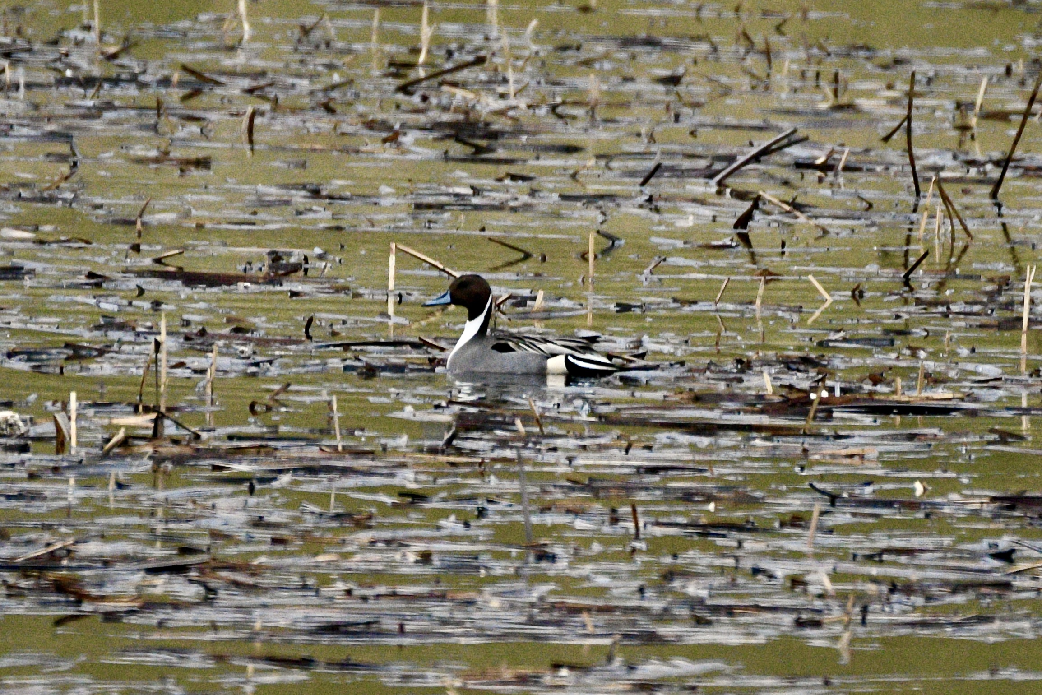
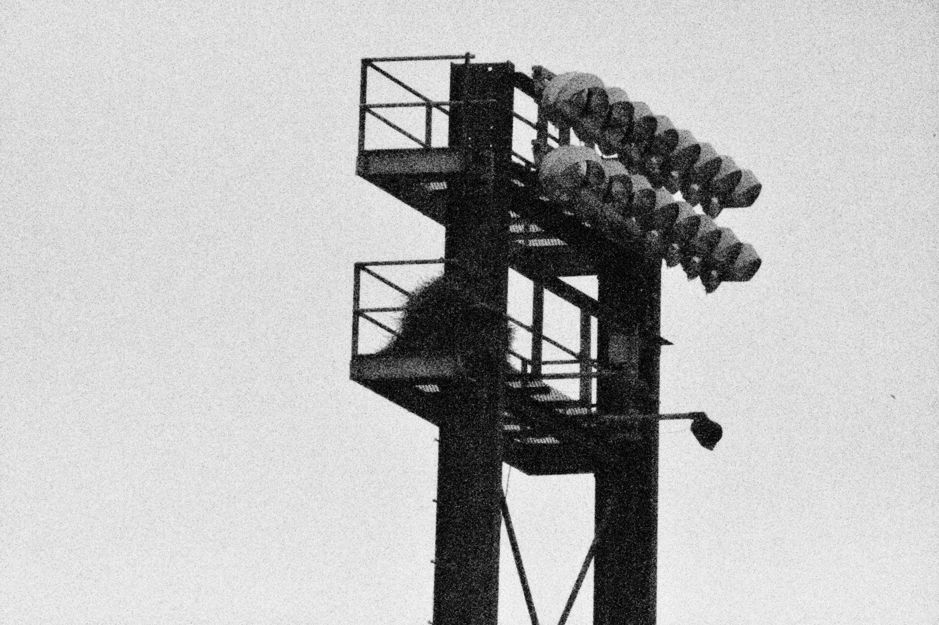
Annette Pasek Photos

Slide 6
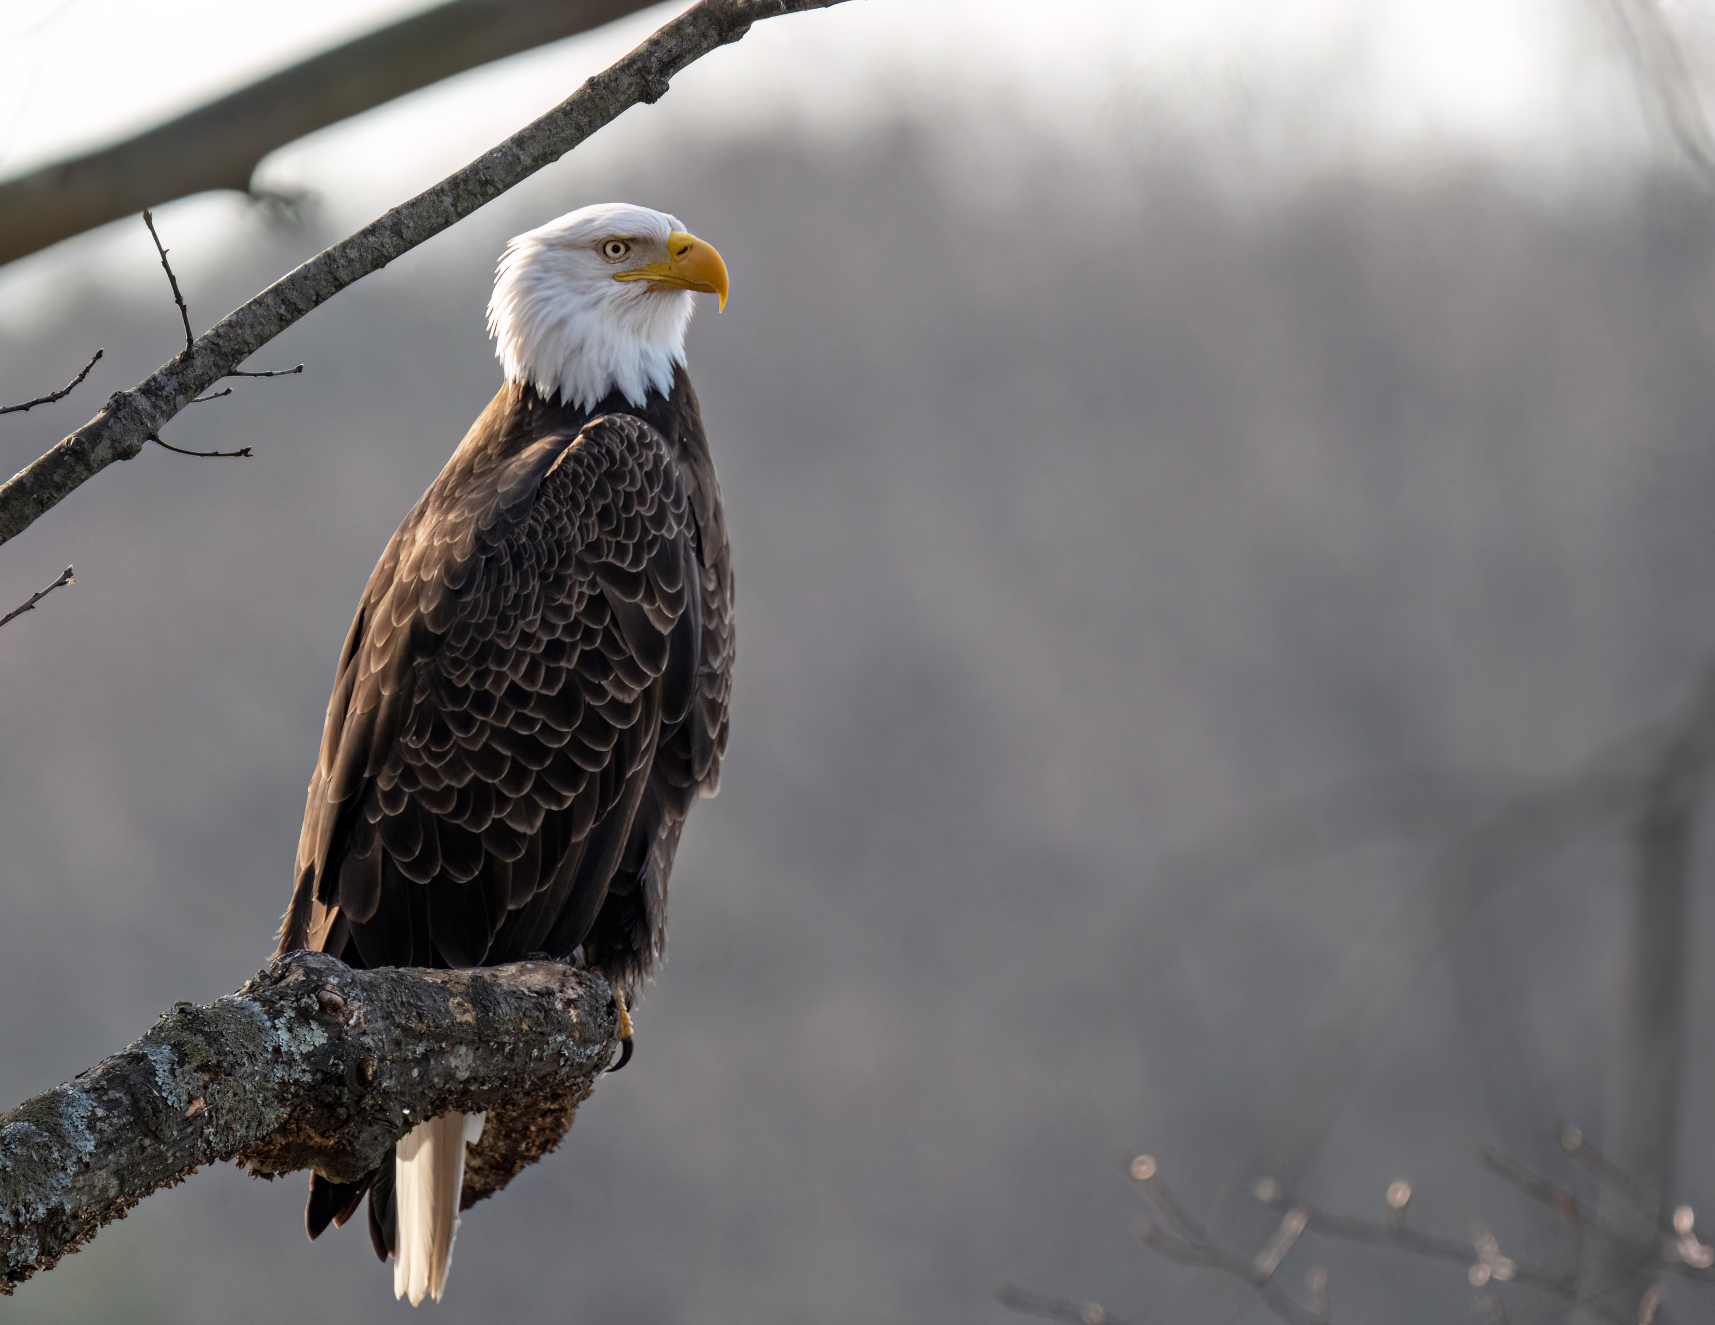
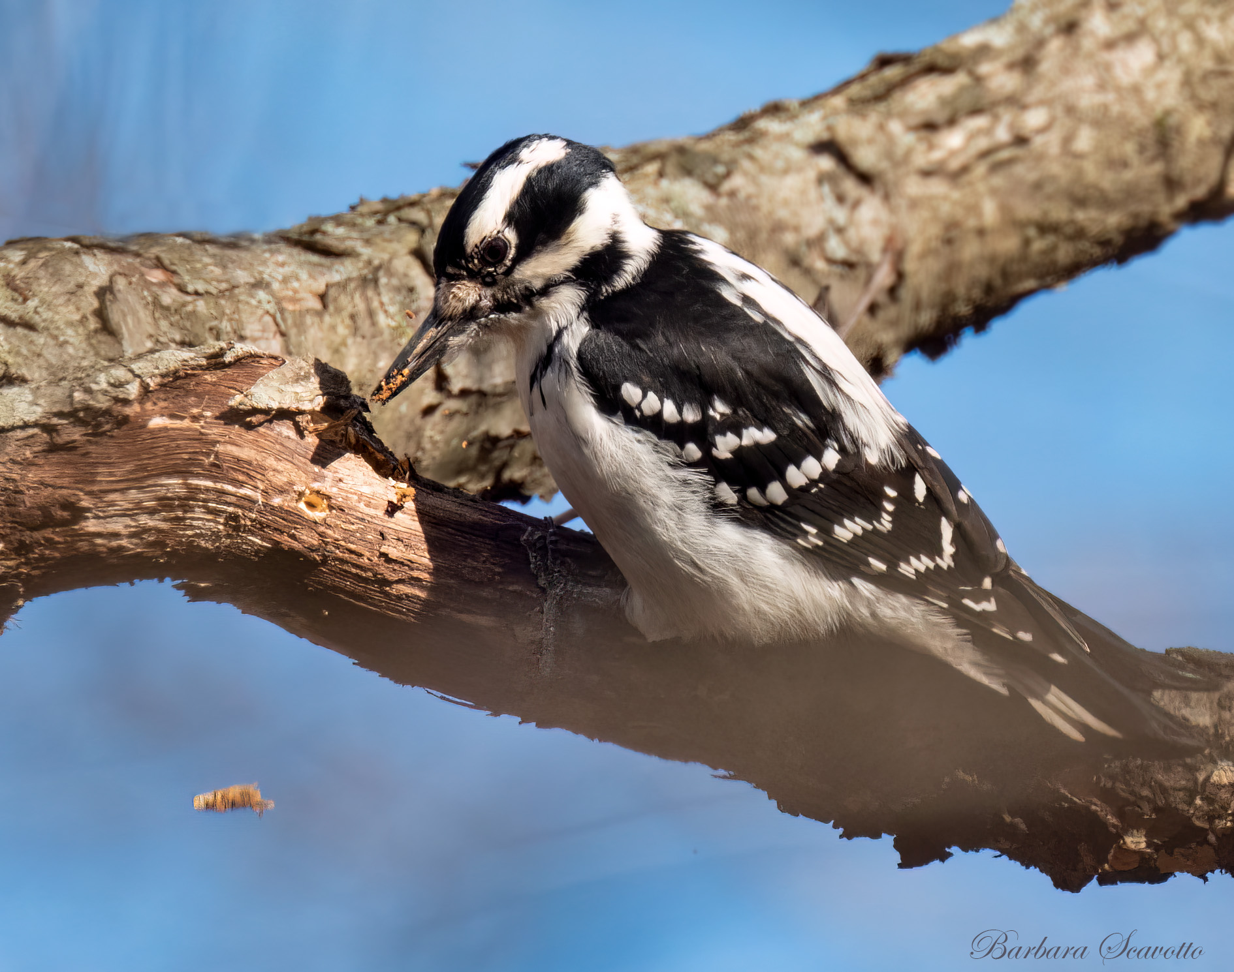
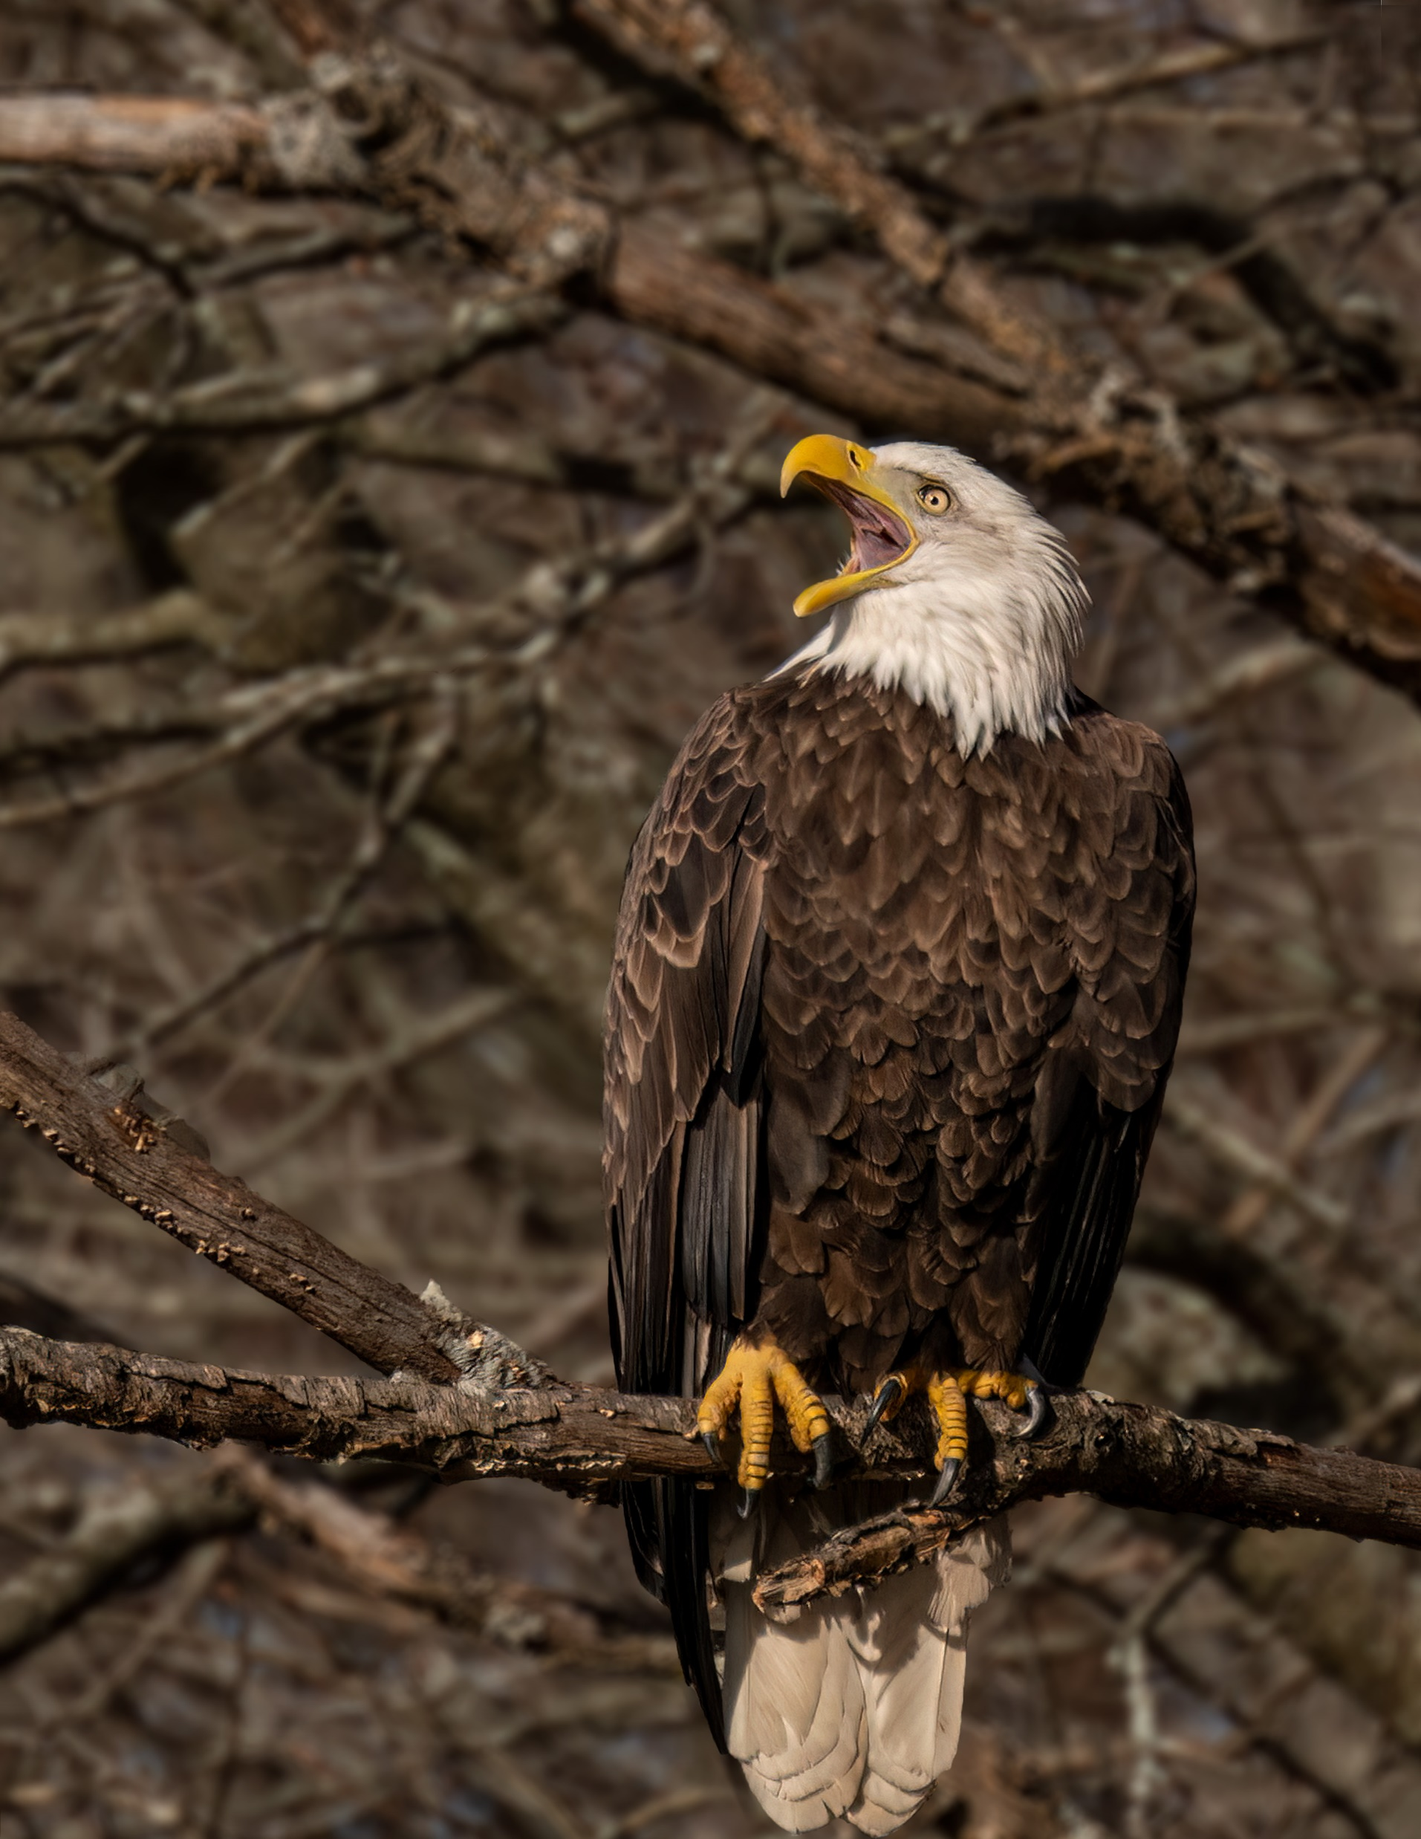
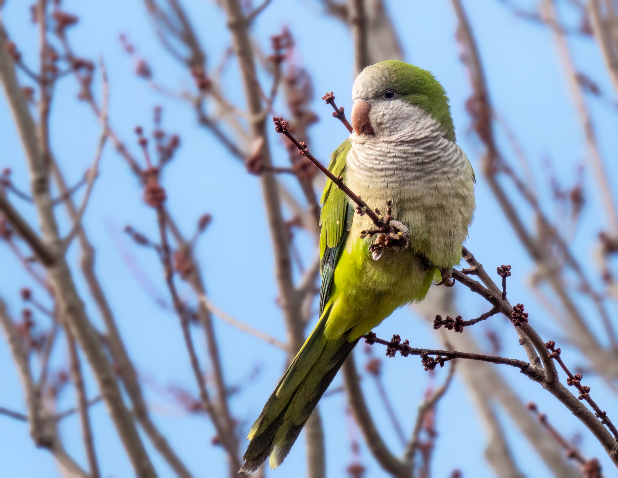
Barbara Scavotto Photos

Slide 7
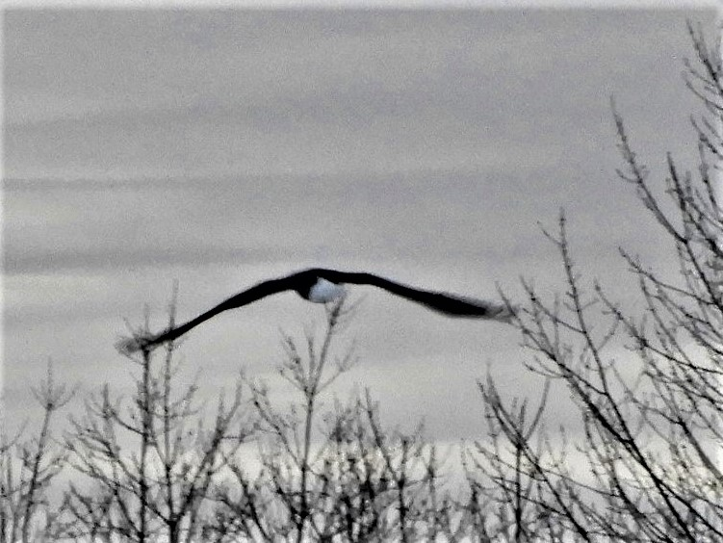
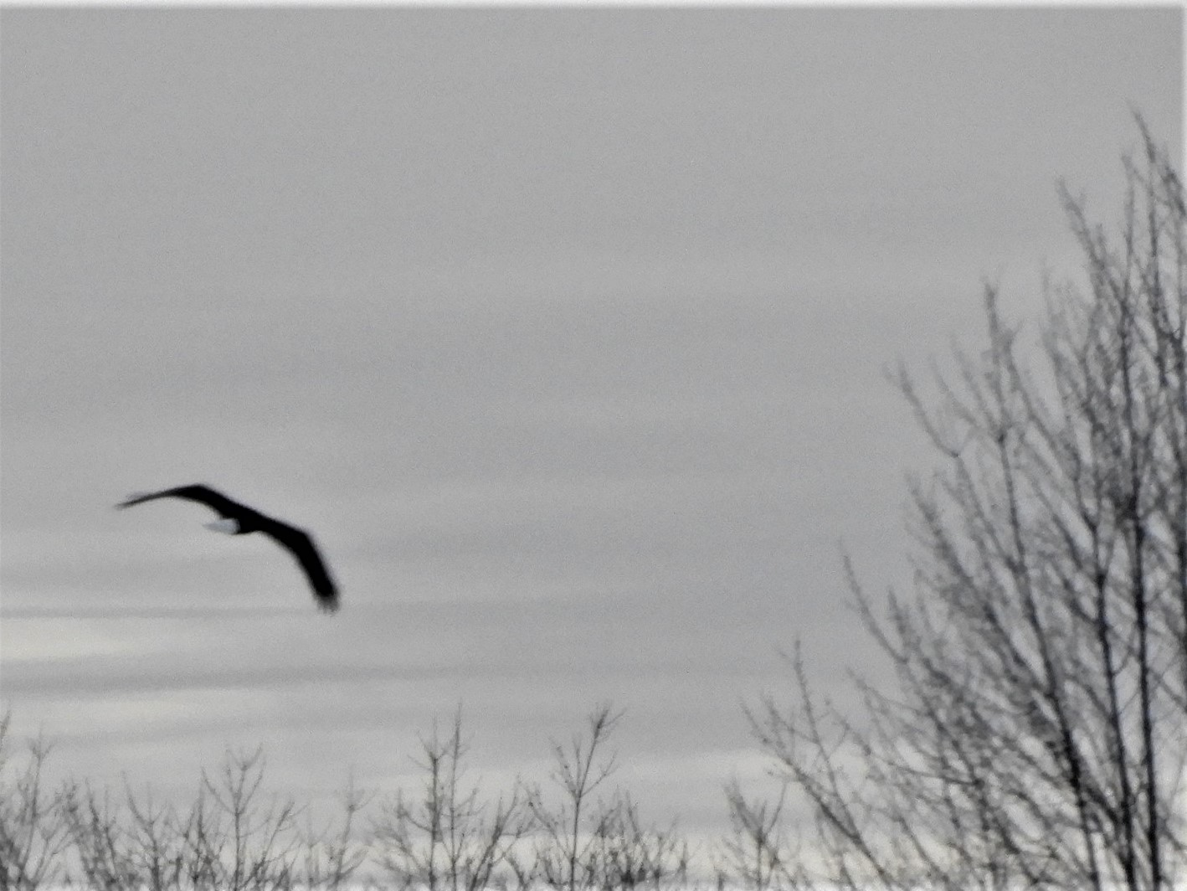
Donna Summer Photos

Slide 8
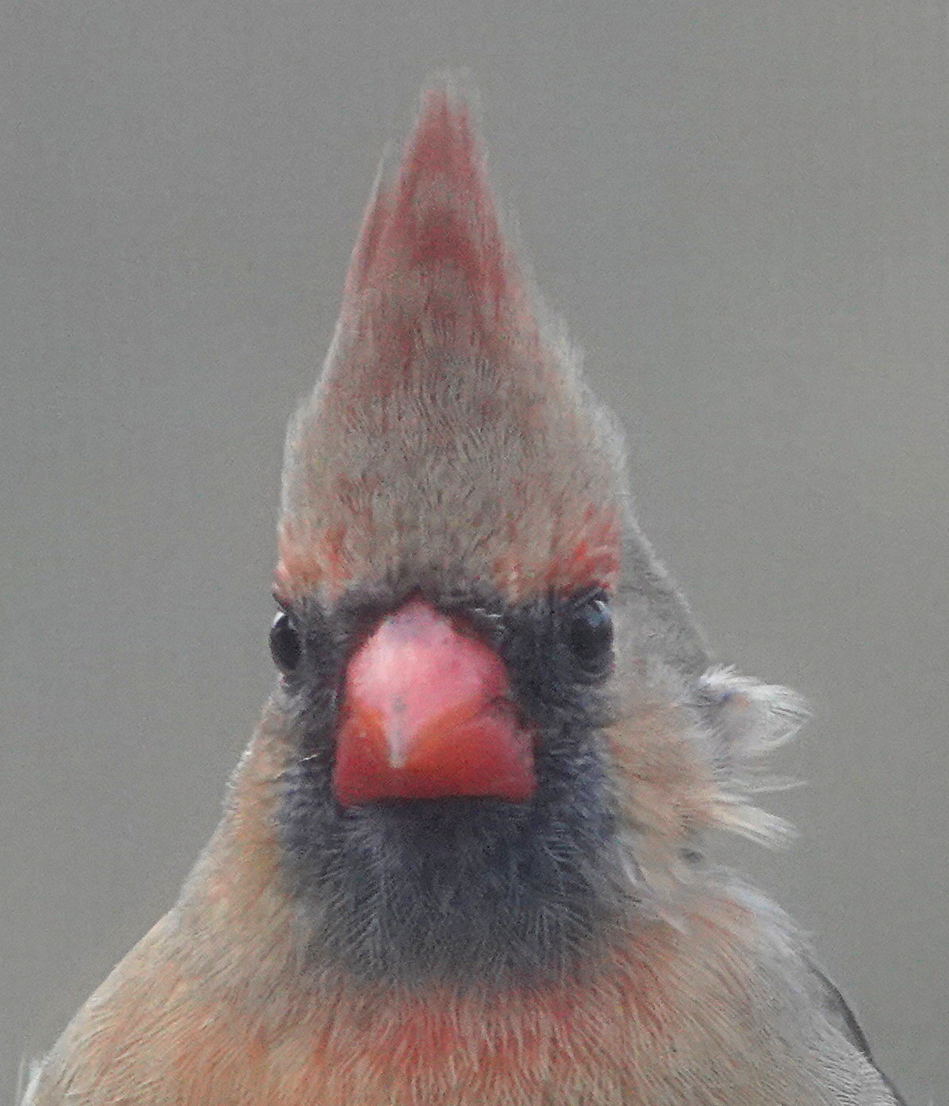
Doug Murray Photo

Slide 9
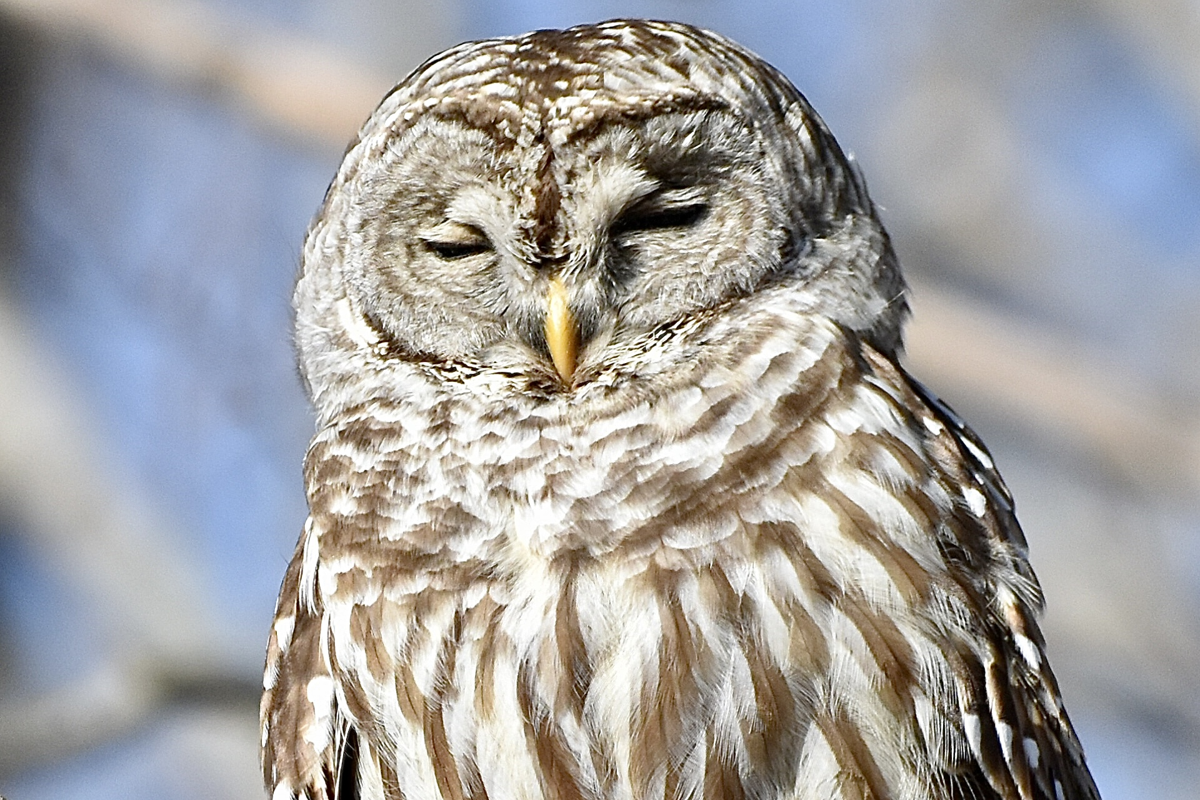
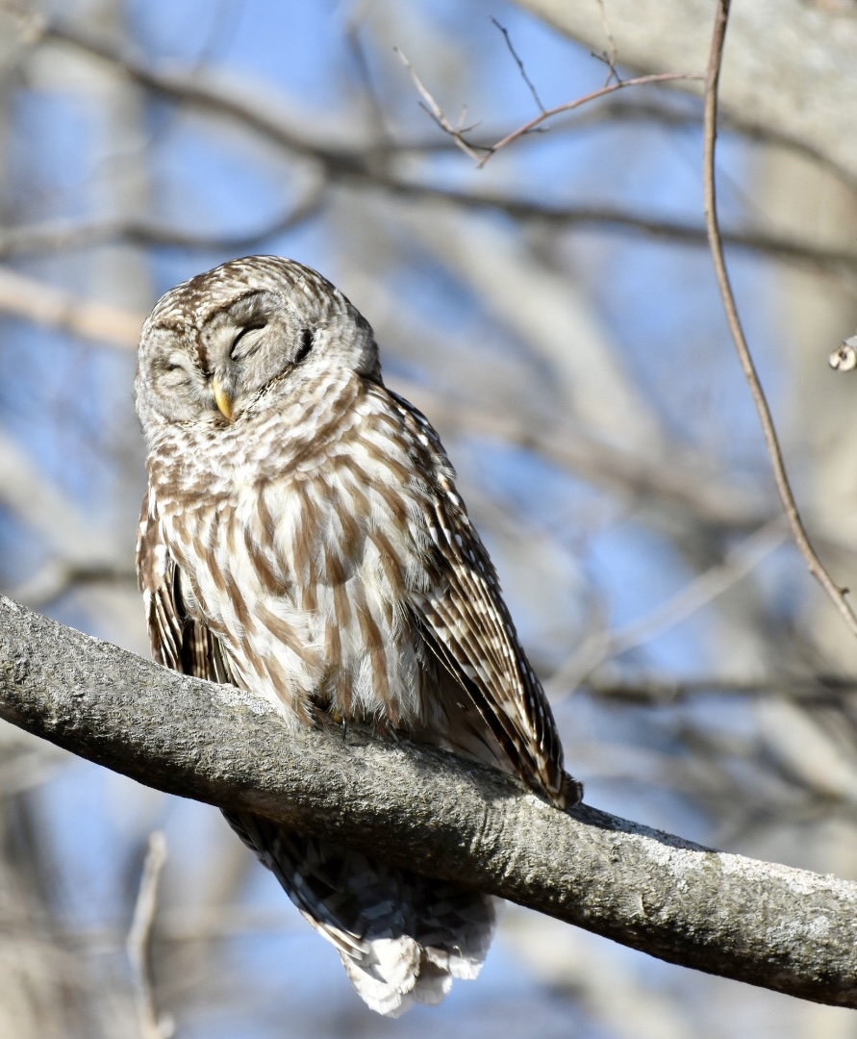
Sophia Marler Photos

Slide 10
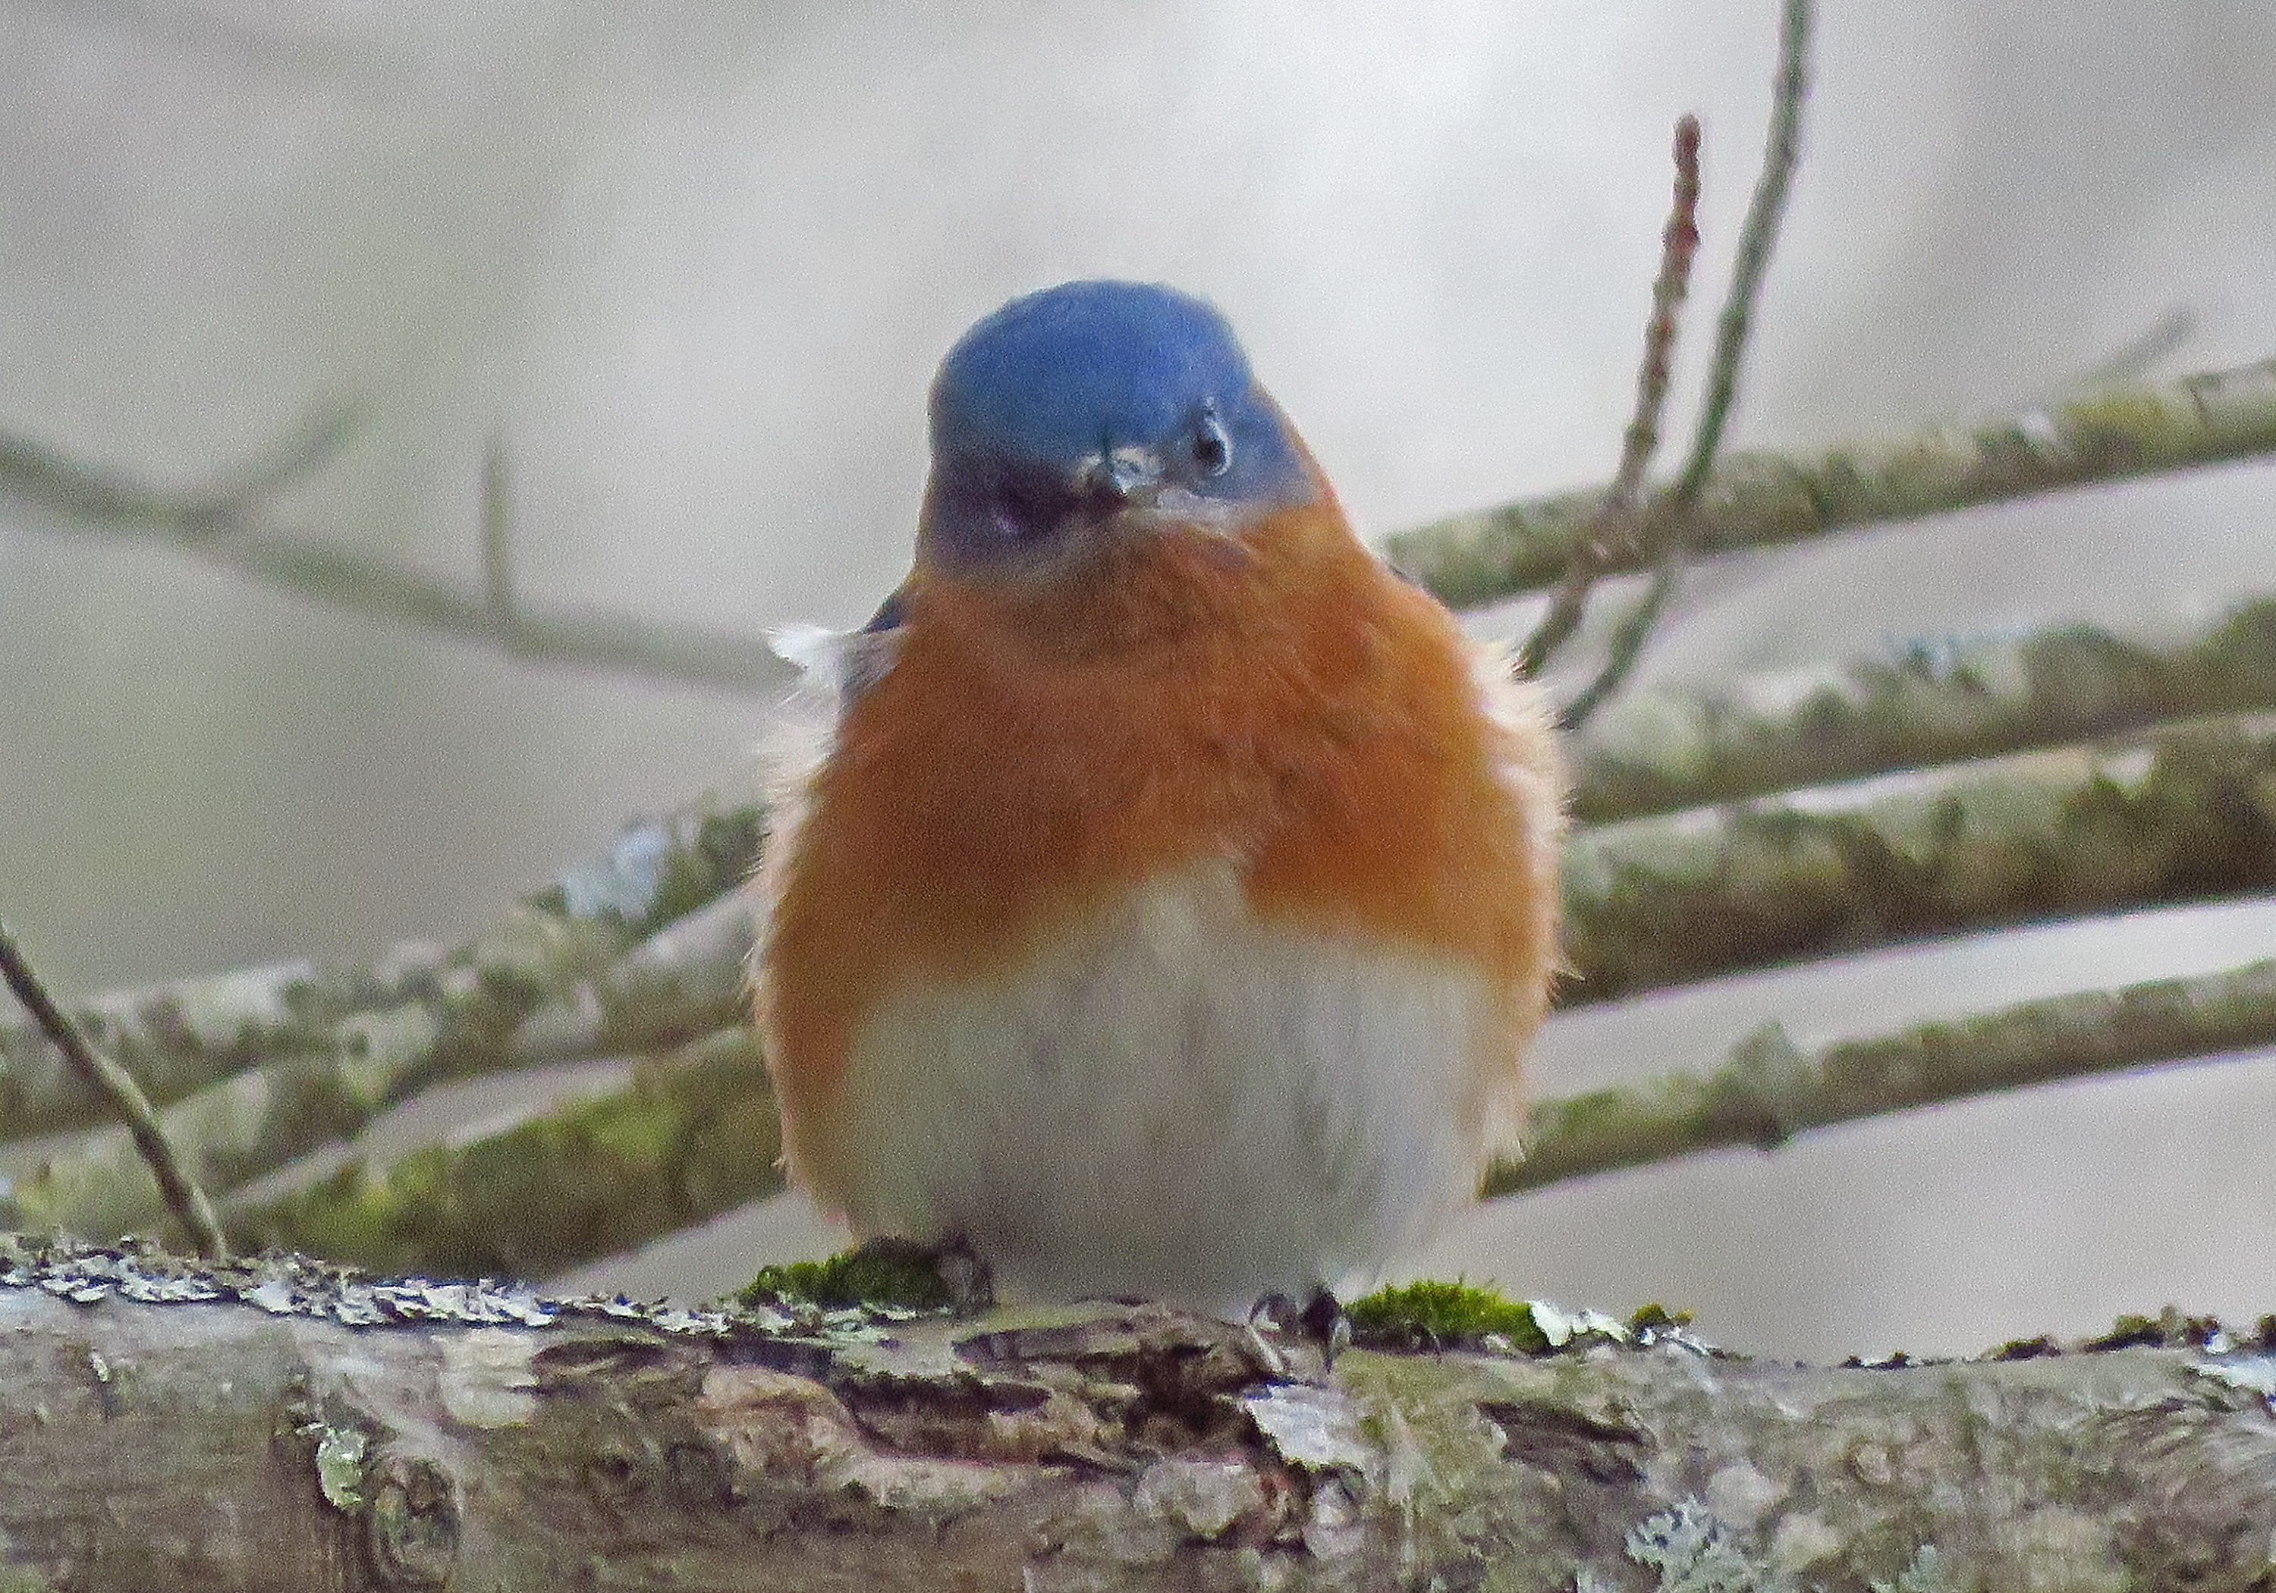
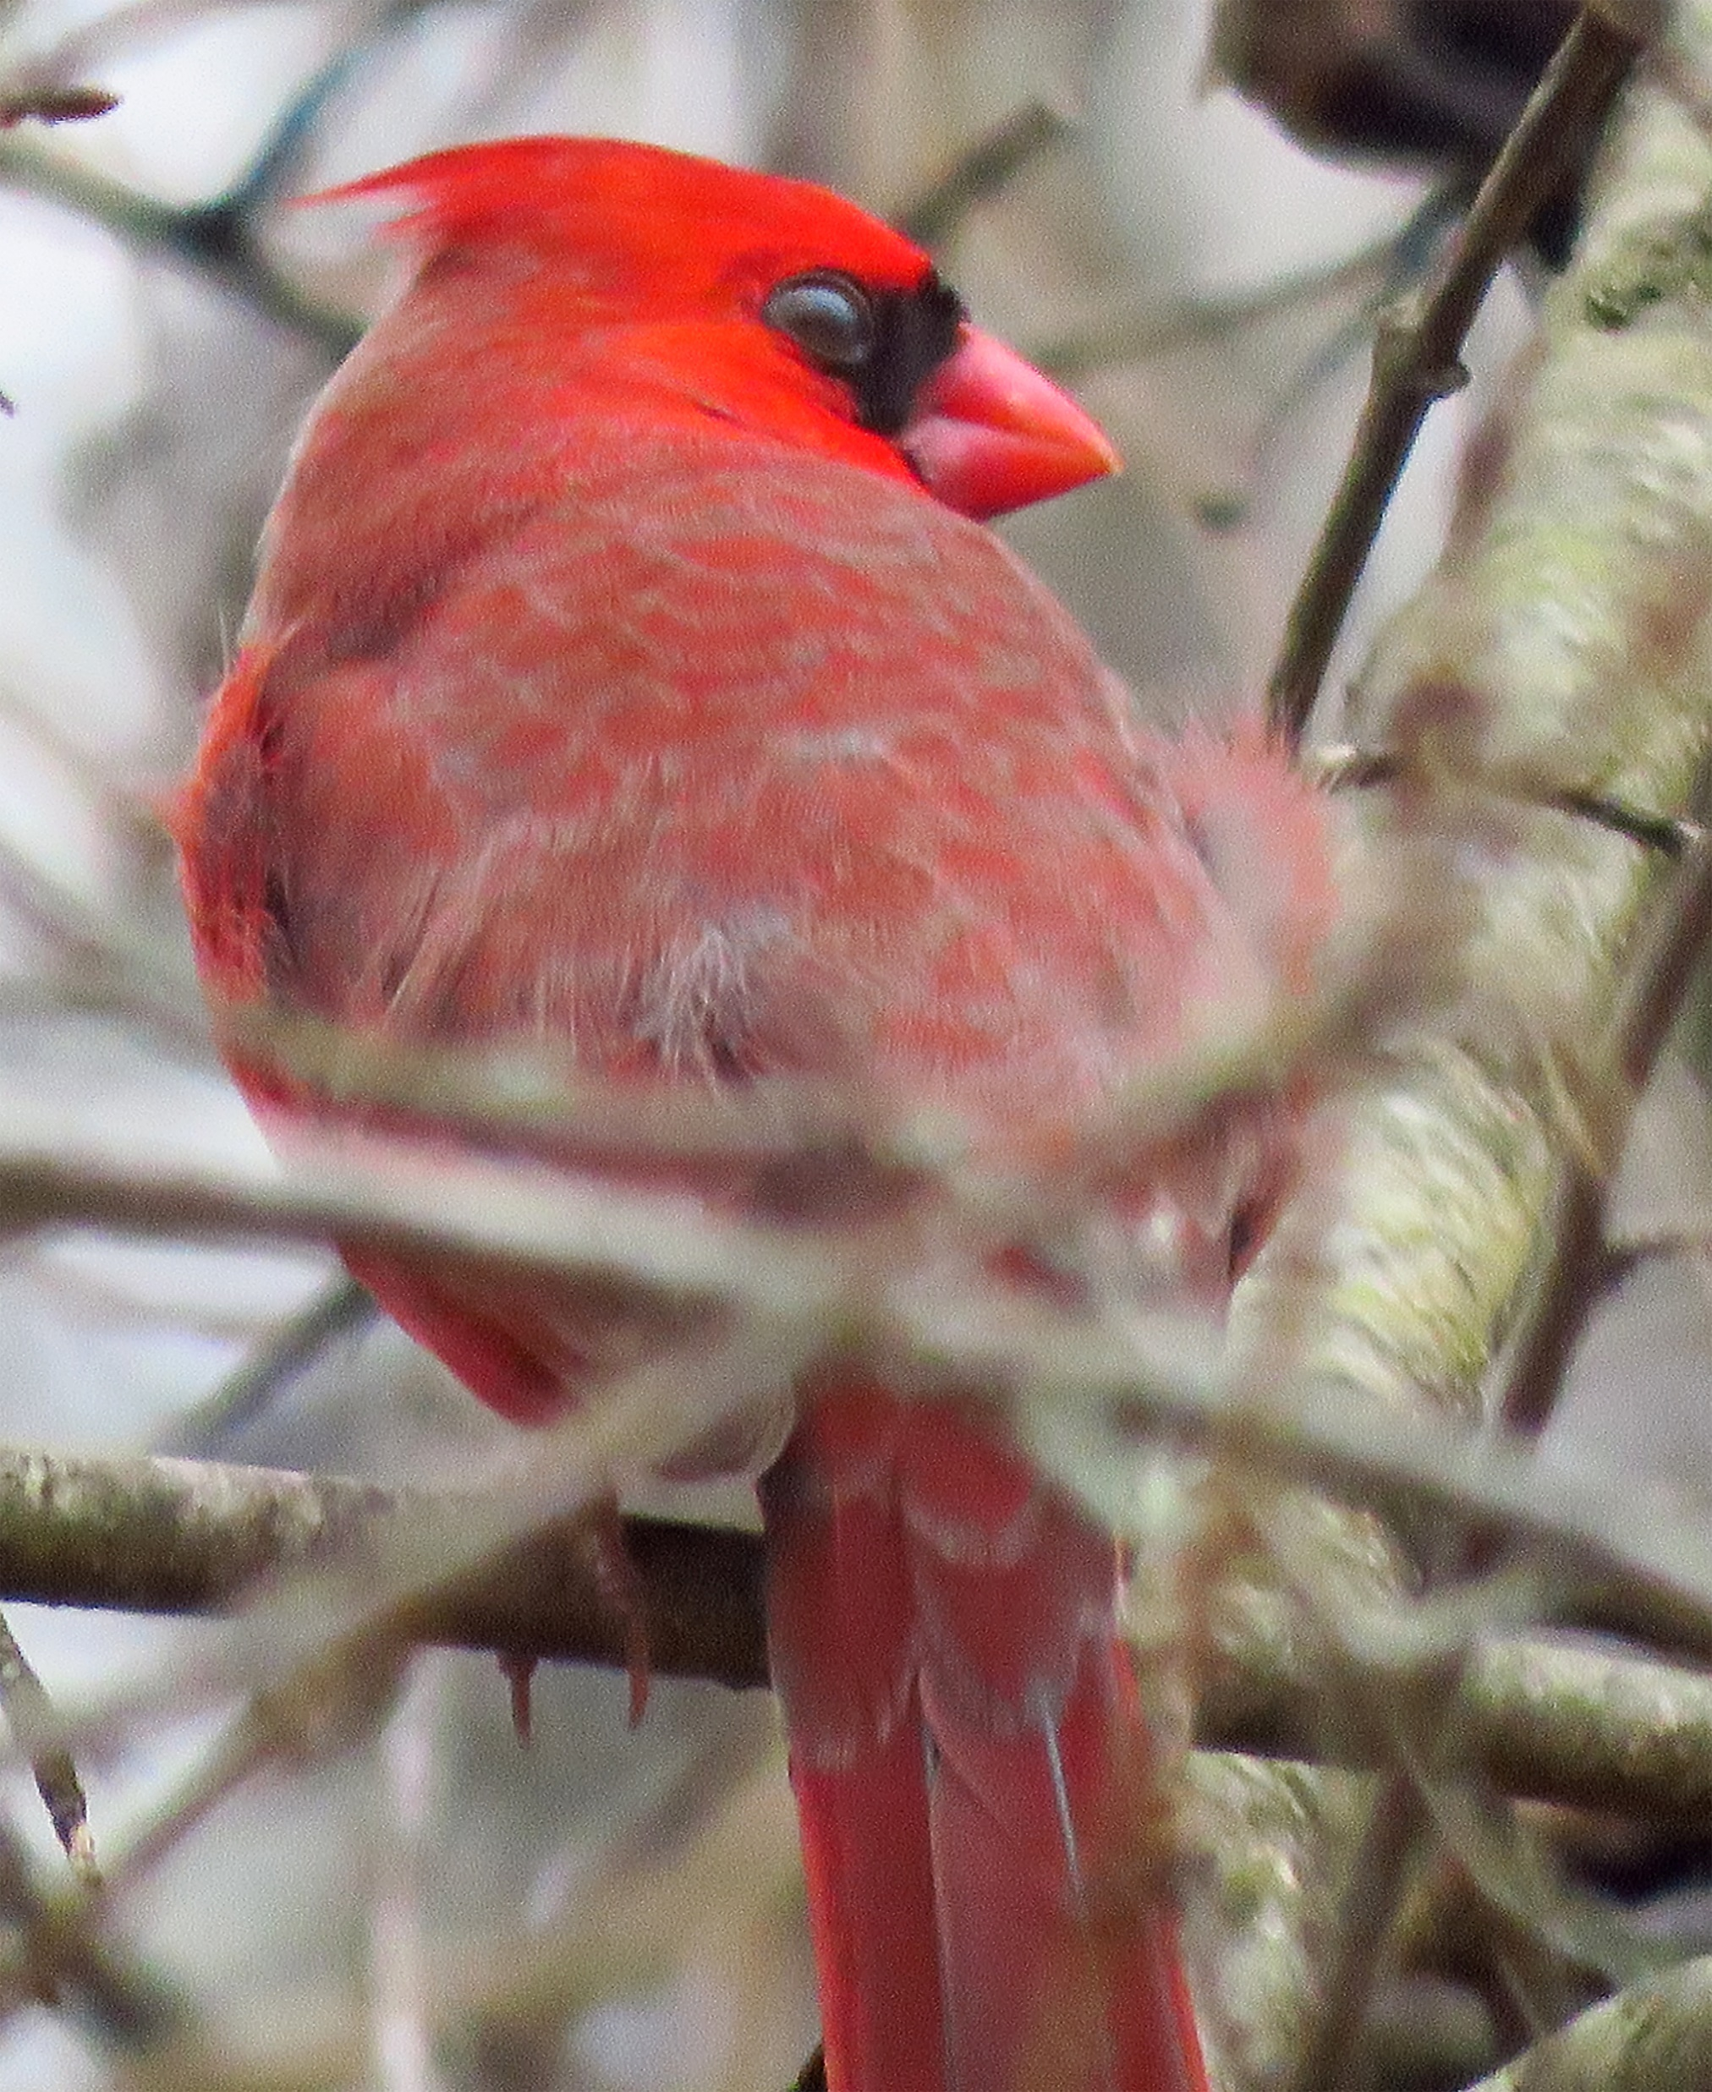
Virge Cask Photos

Slide 11
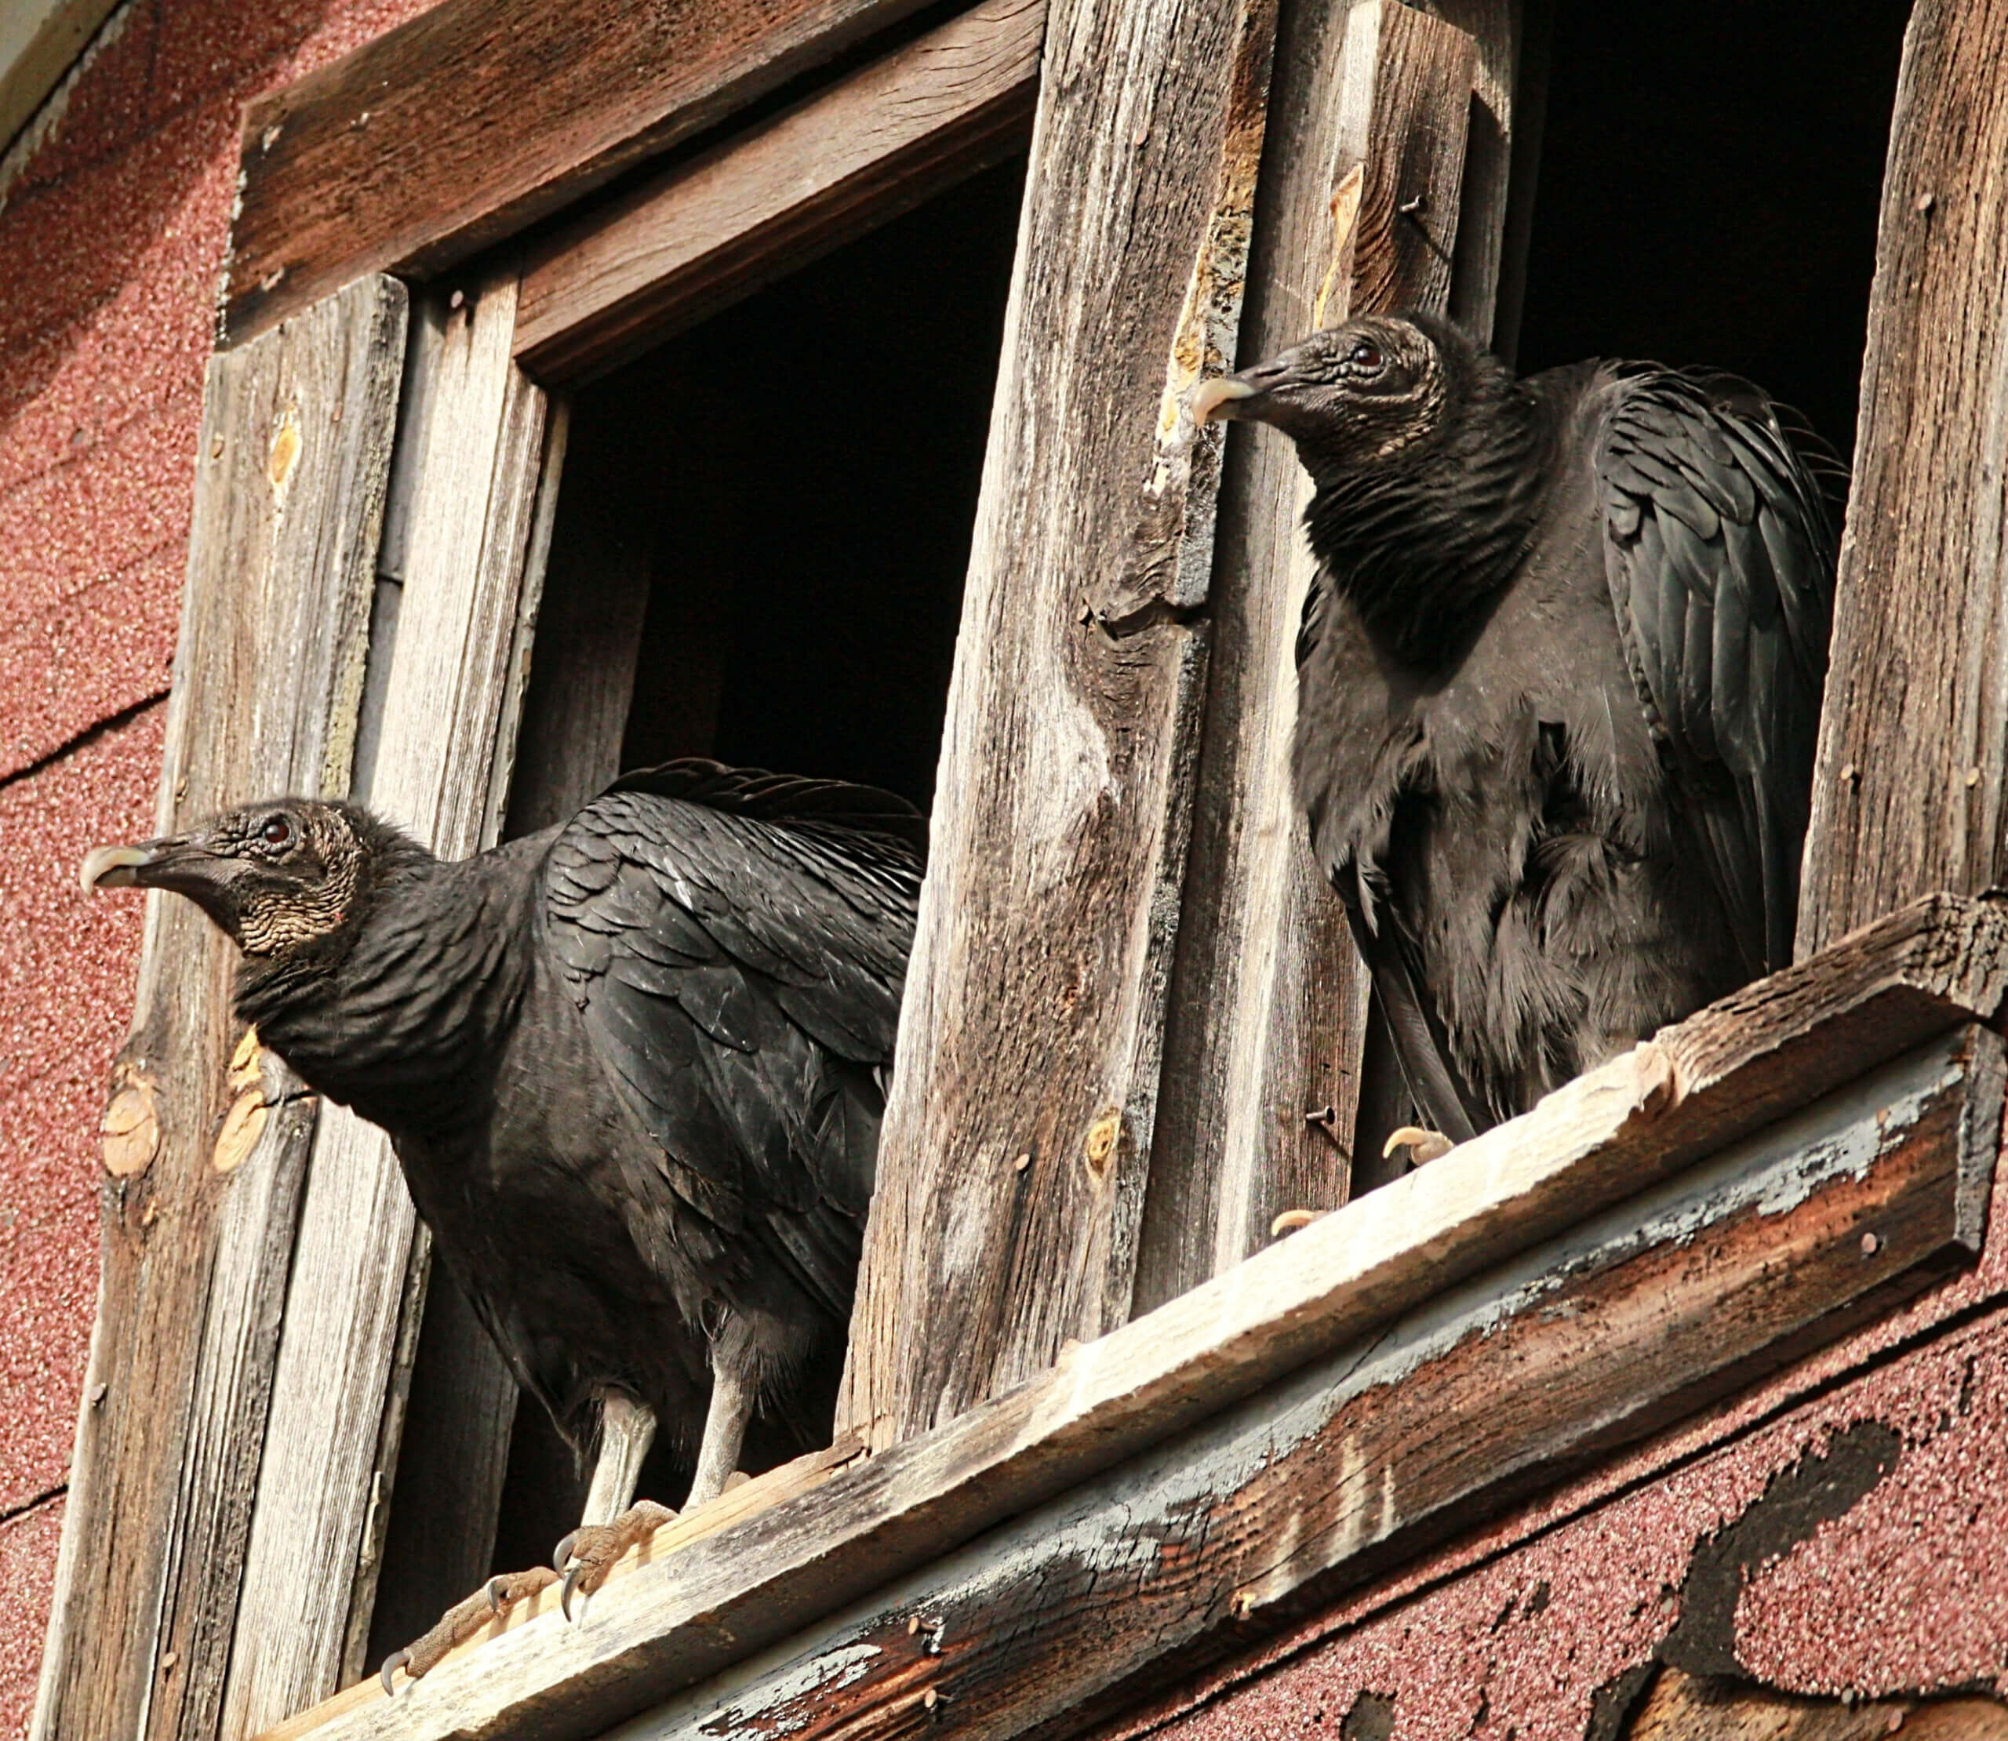
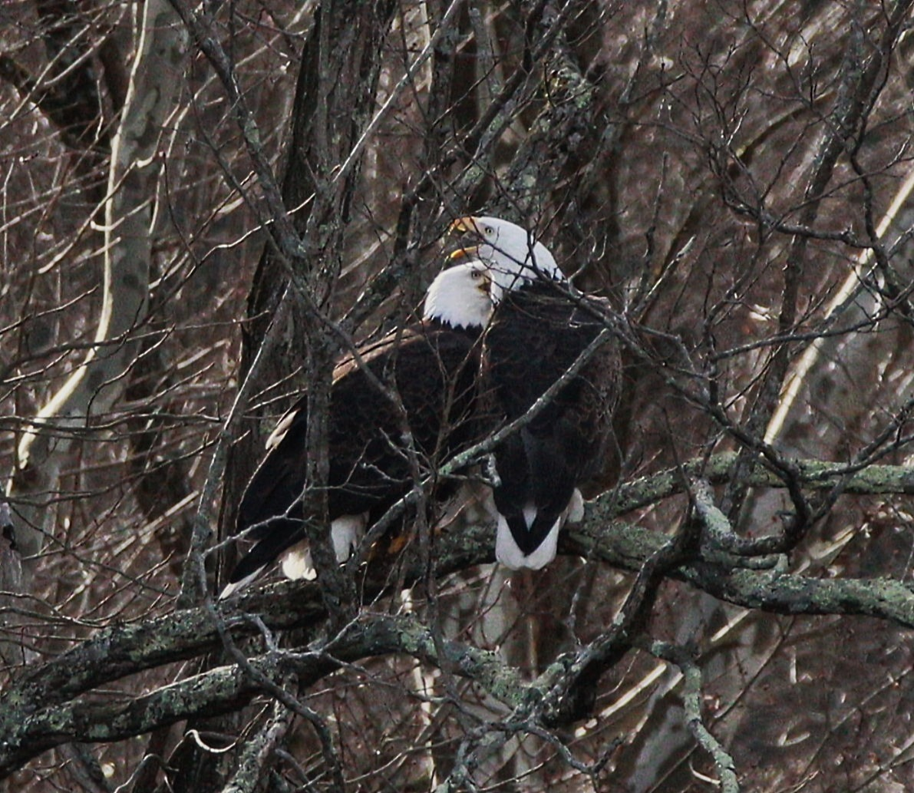
Glenn Berger Photos

Slide 12
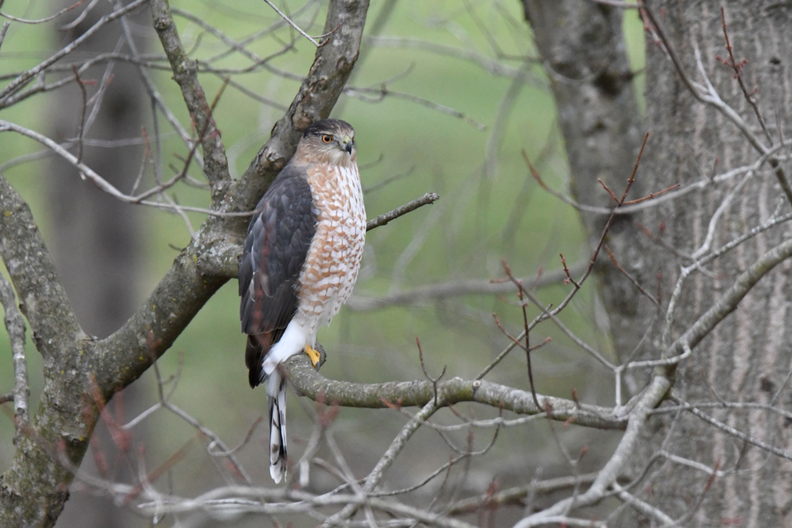
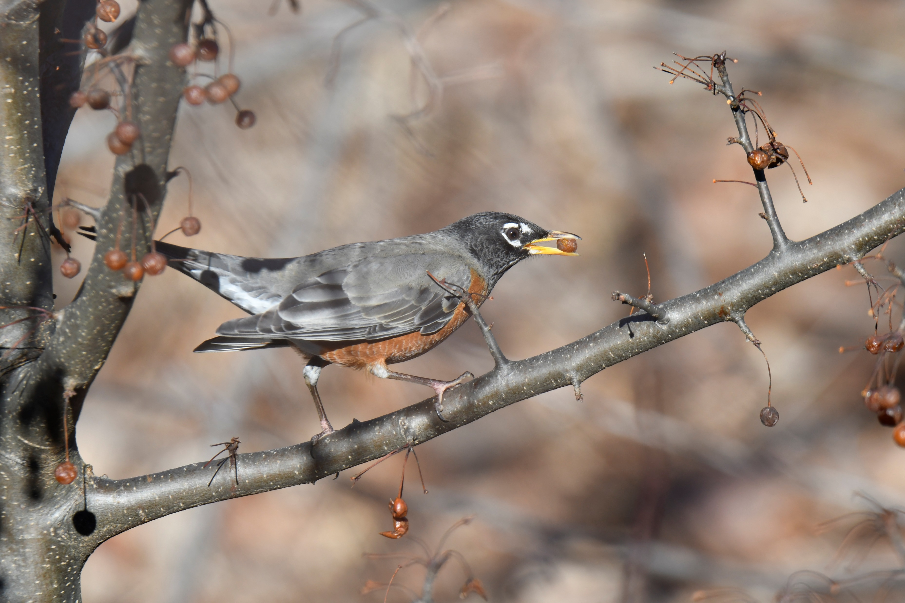
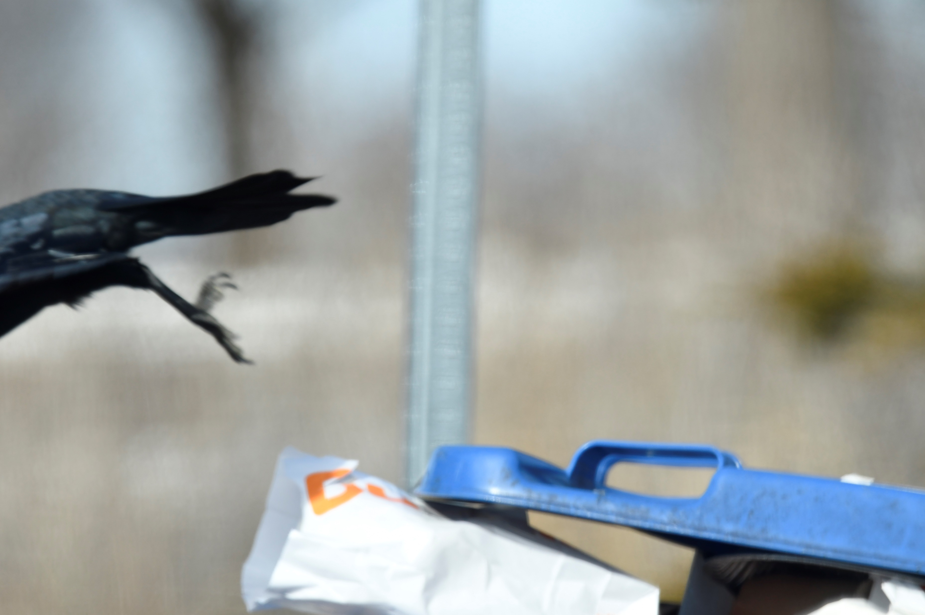
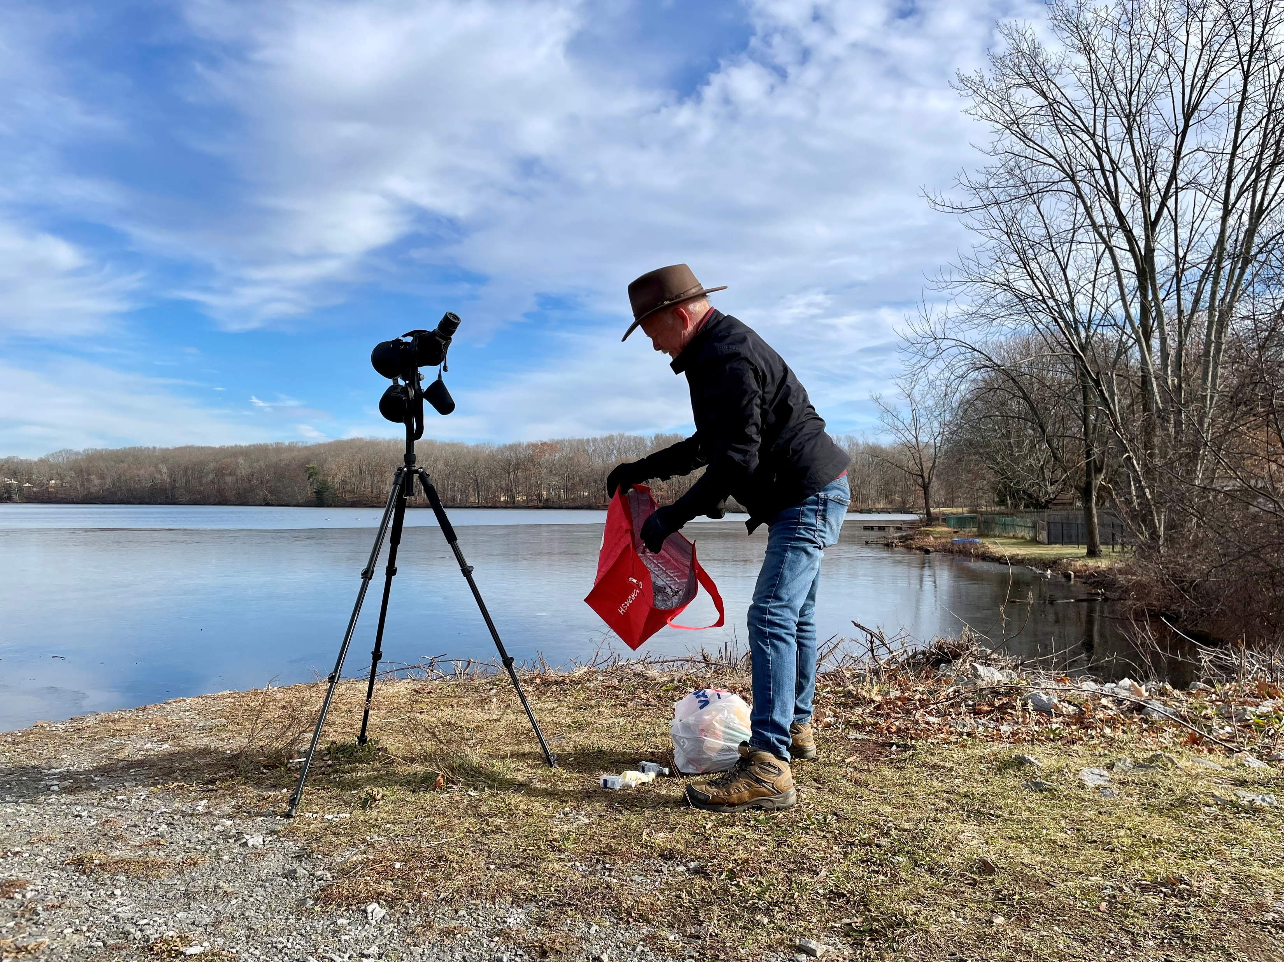
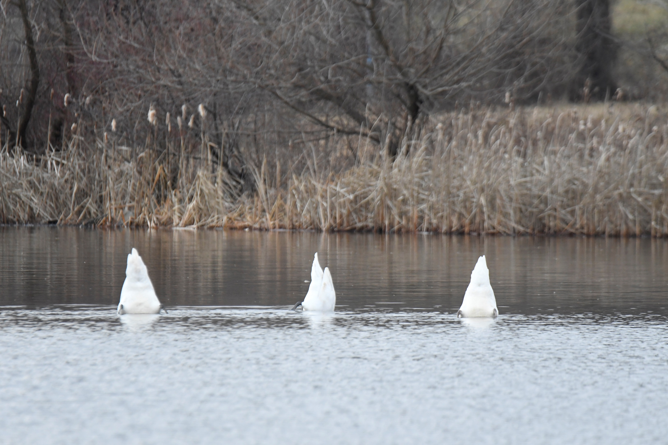
Joan Heffernan Photos

Slide 13
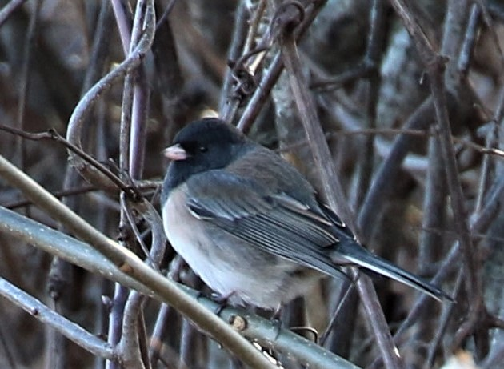
Maggie Peretto Photo

Slide 14
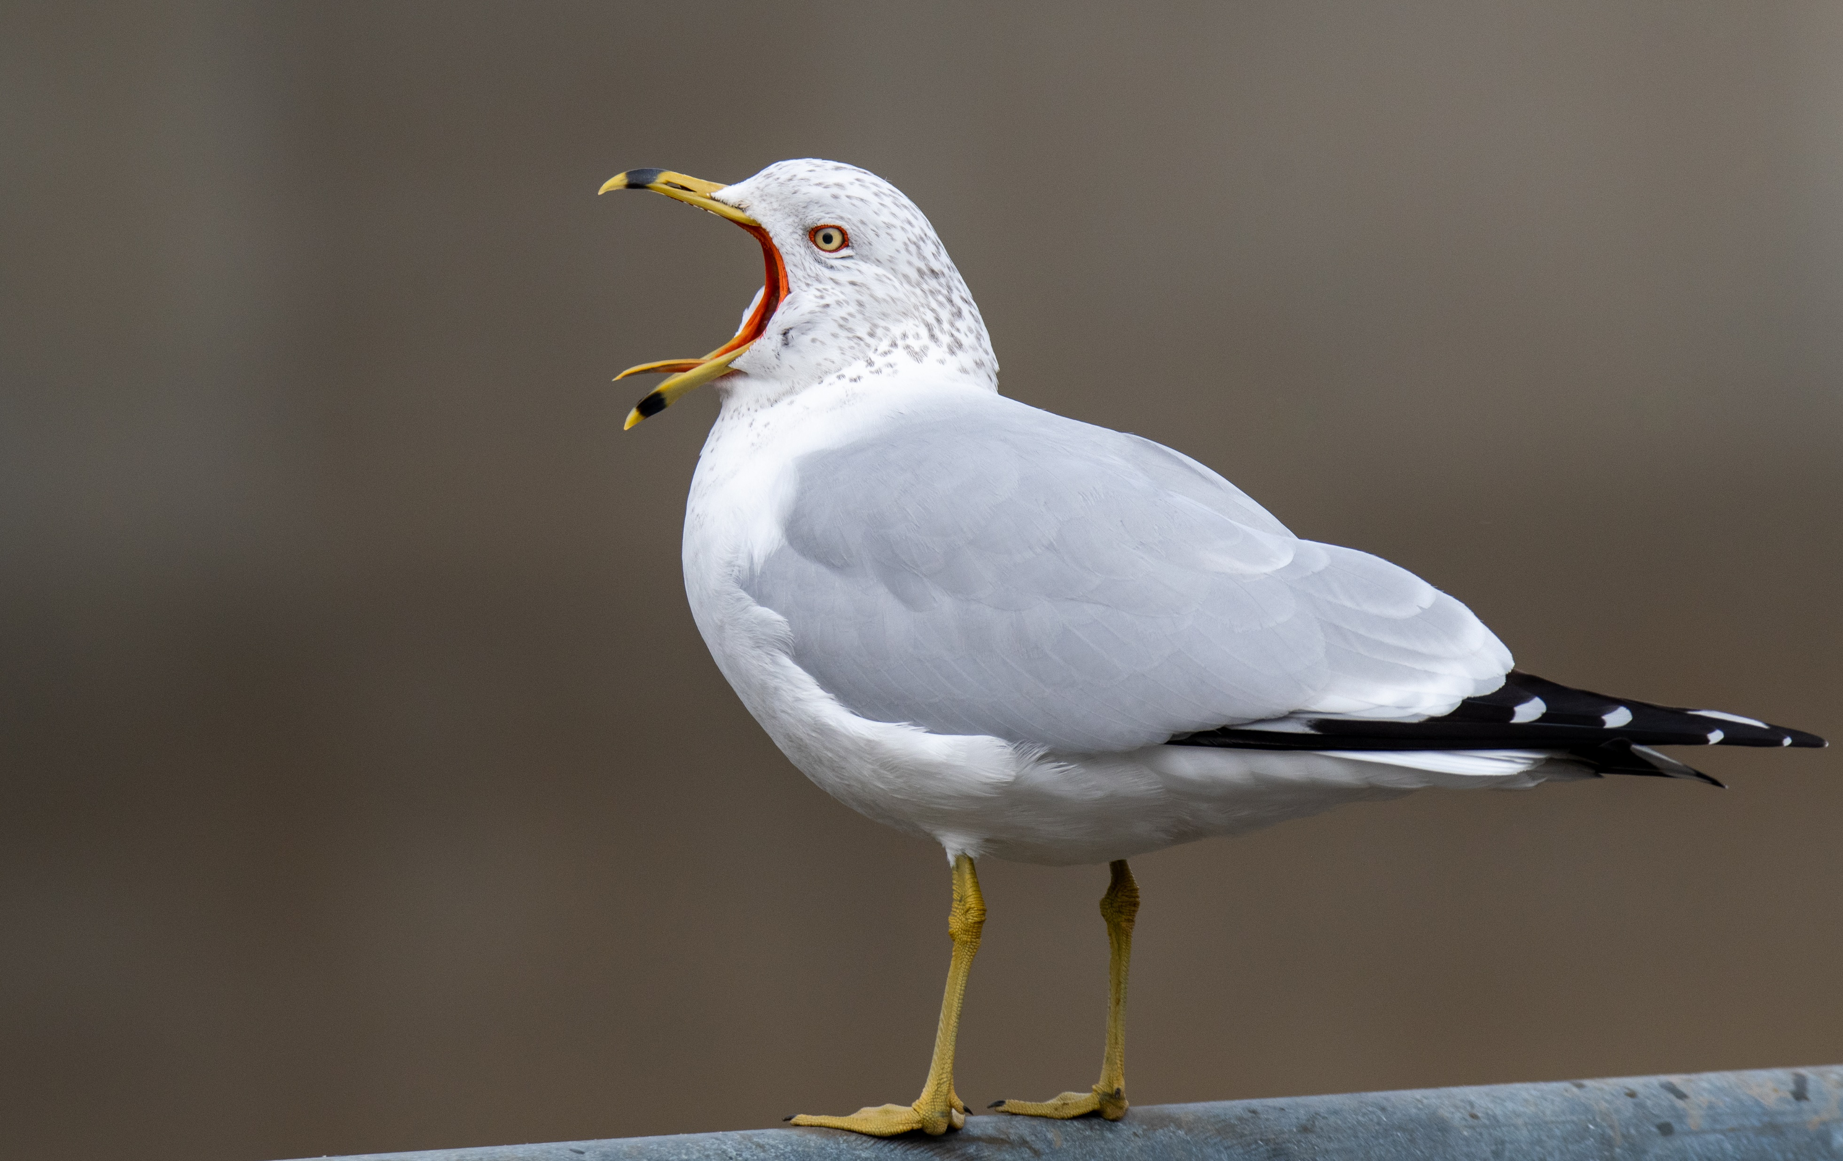
Martin Kaehrle Photo

Slide 15
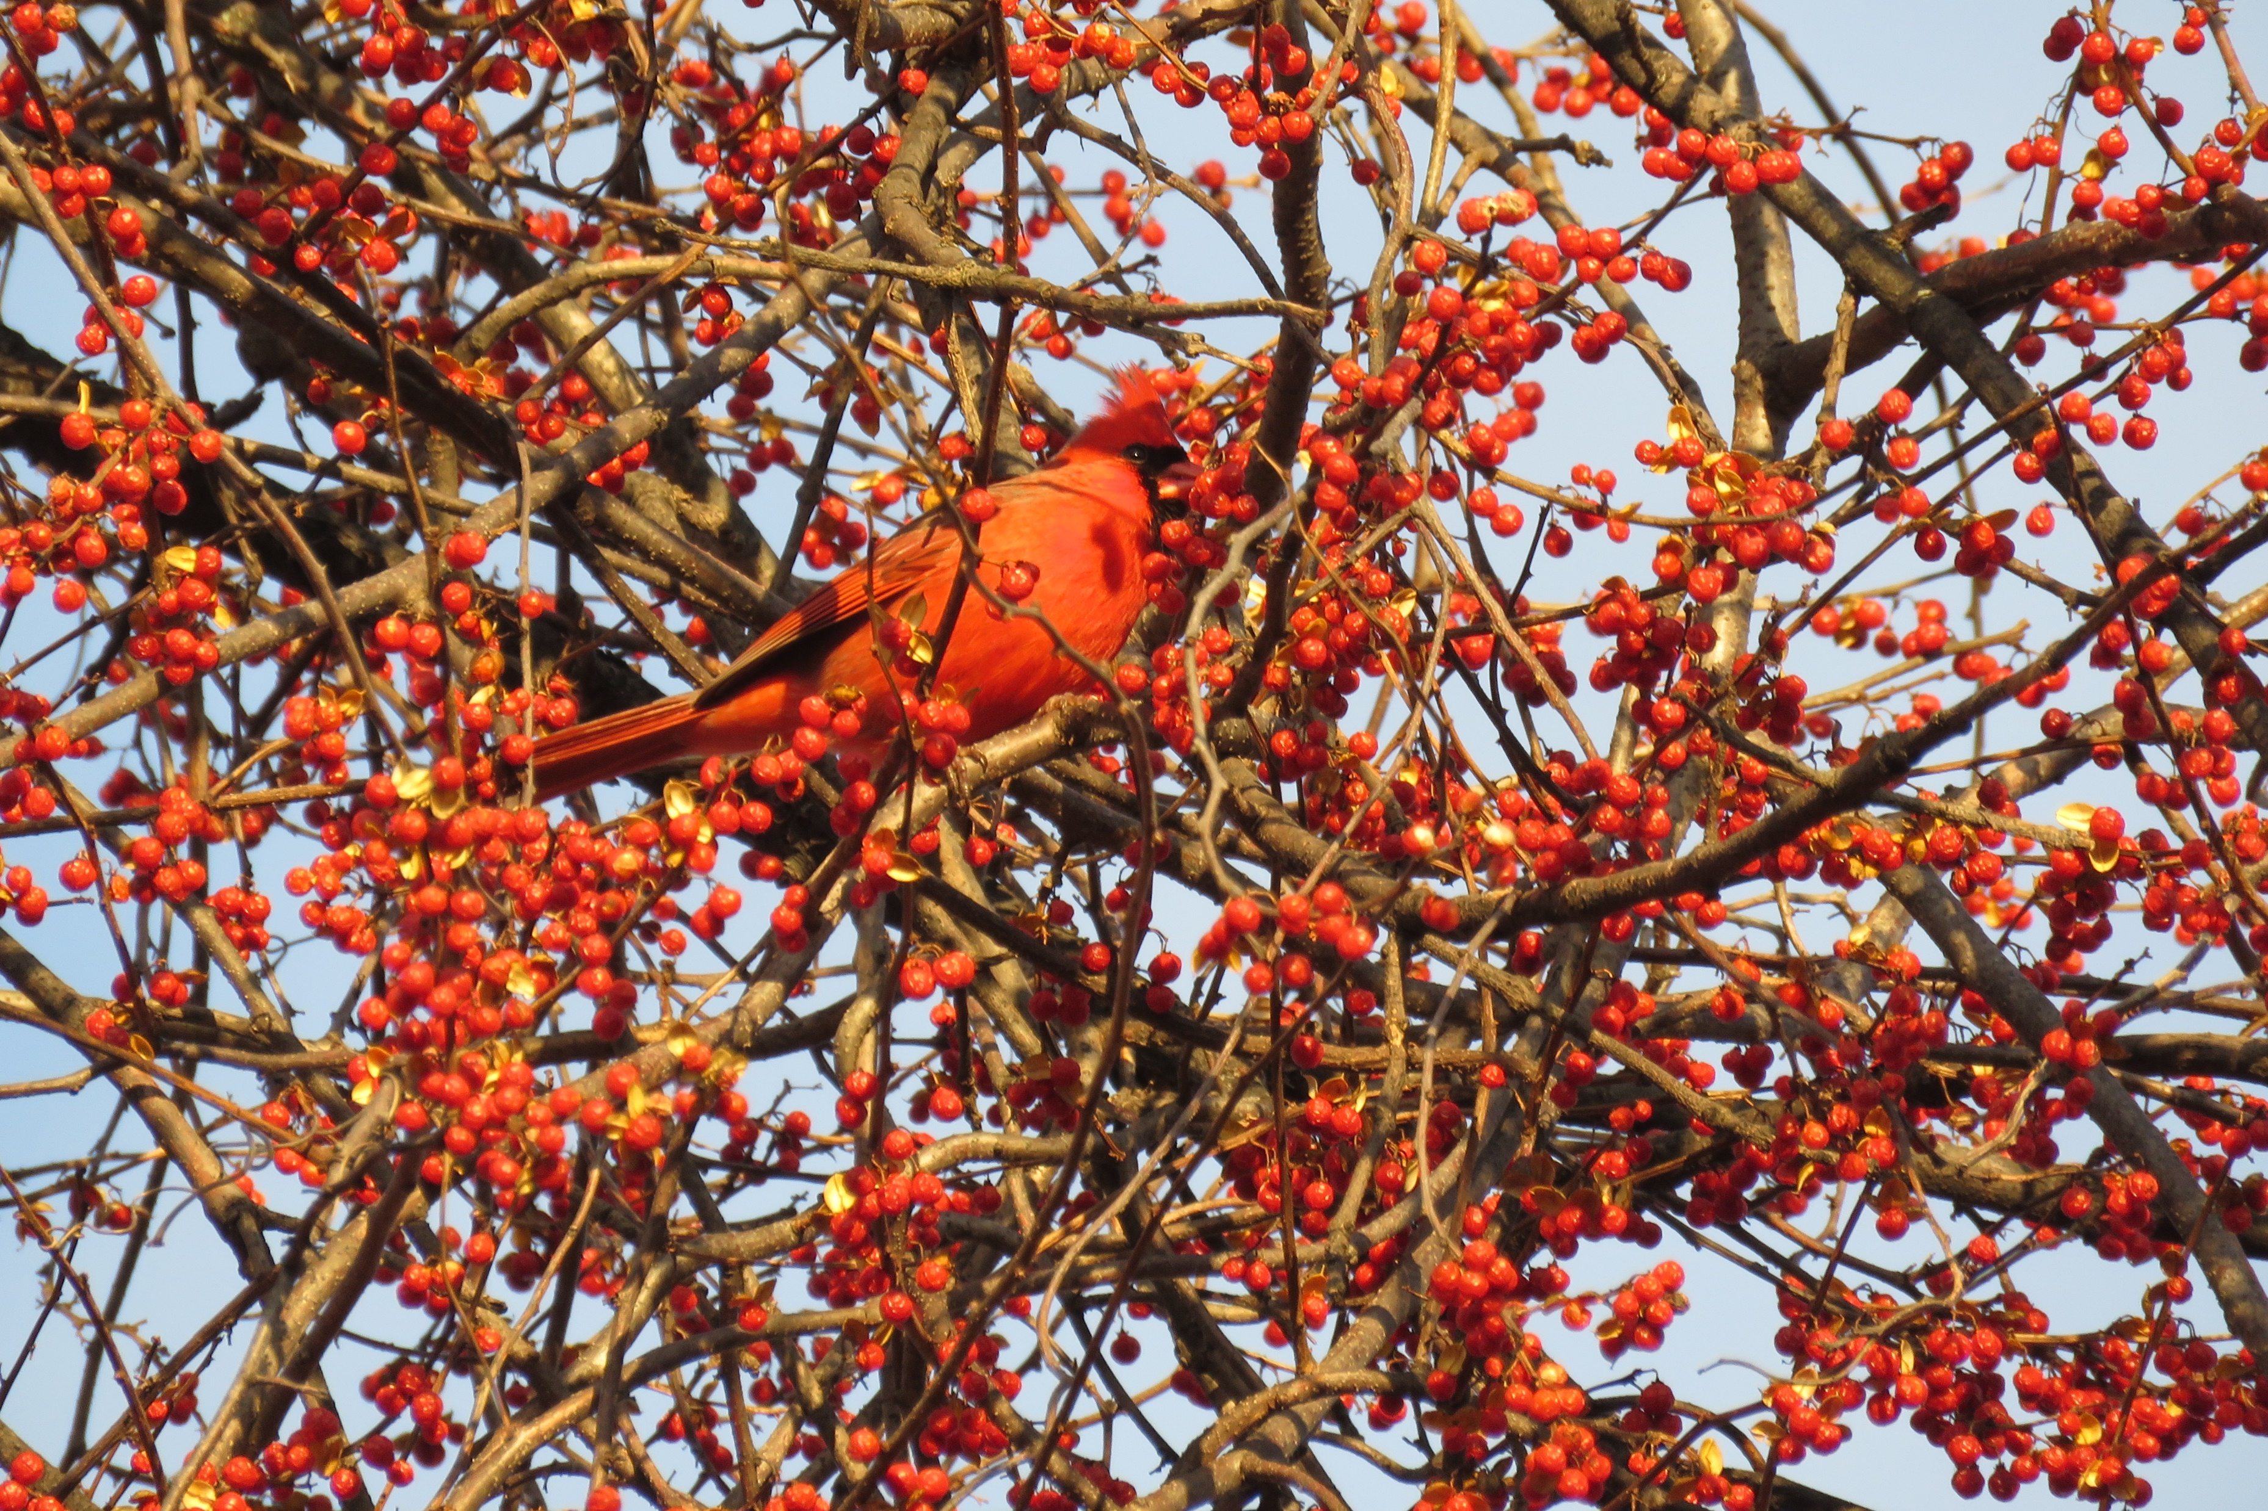
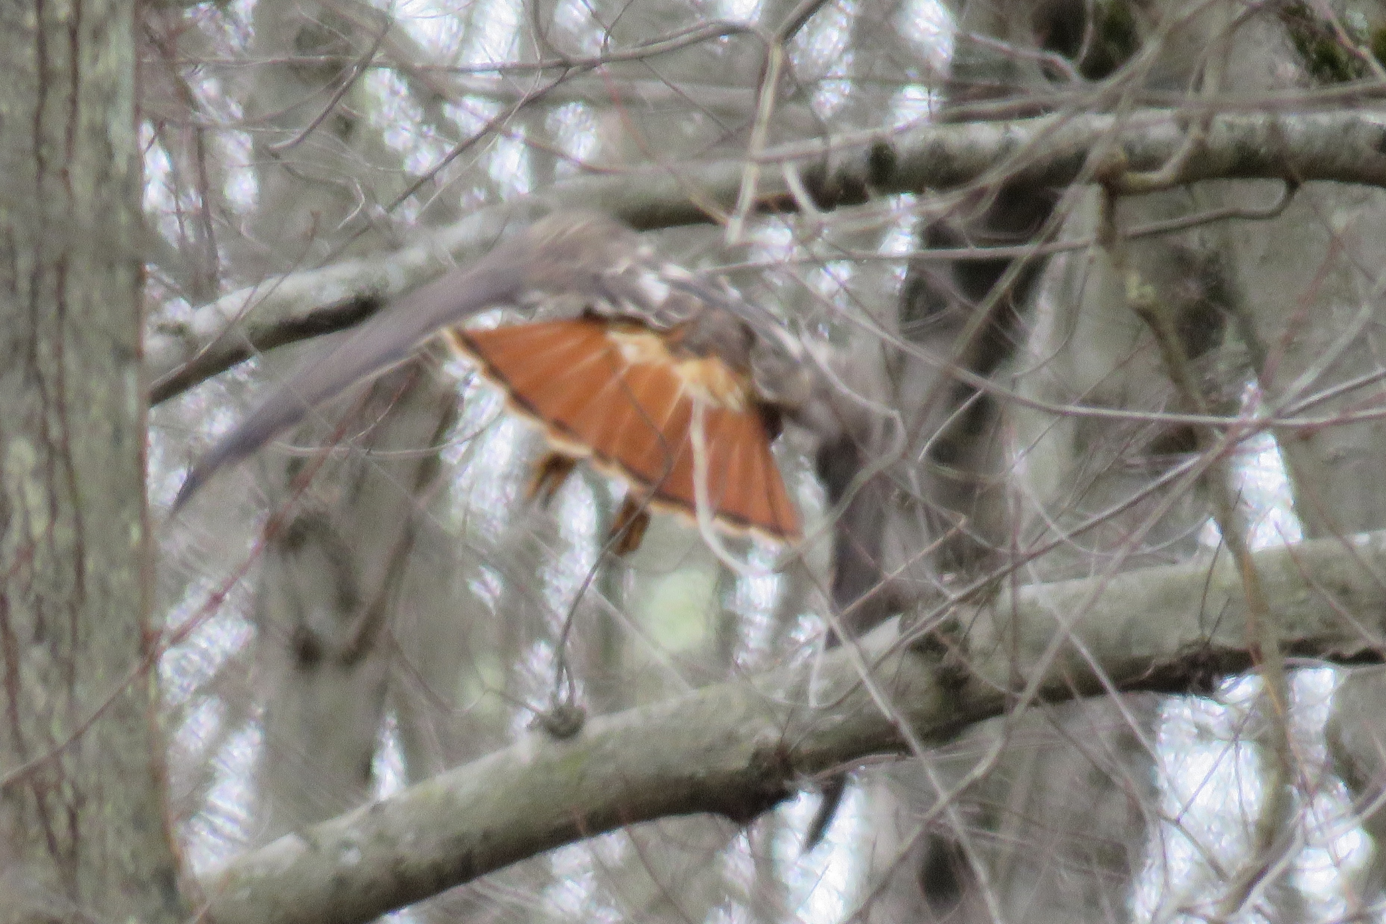
Sarah Faulkner Photos

Slide 16
And the Winners!
Category | Photographer | Photo
Best Overall | Glenn Barger | Black Vultures
Bird Behavior | Barbara Scavotto | Hairy Woodpecker
Rarest Bird | Maggie Peretto | Oregon Junco
Birders | Joan Heffernan | Conservation/Clean up
Oops | Joan Heffernan | Crow??
Funniest | Joan Heffernan | Swans

Slide 17
Best Overall
Bird Watching goes both ways!
Photographer - Glenn Barger

Slide 18
Bird Behavior
Hairy Woodpecker searching for lunch
Photographer – Barbara Scavotto

Slide 19
Rarest Bird
Oregon Junco – surprised to see this bird along with 60 other Juncos!
Photographer – Maggie Peretto

Slide 20

Birders
As well as a birder, I’m an environmentalist. For every location we visit, whether hiking, walking or birding, we collect trash that is harmful to all habitats as well as unsightly.
Photographer – Joan Heffernan

Slide 21

OOPS!
Raven, Crow, Fish Crow? We’ll never know!
Photographer – Joan Heffernan

Slide 22

Funniest
Swans – Audition for Swan Lake – Bottoms up!
Photographer – Joan Heffernan

Slide 23
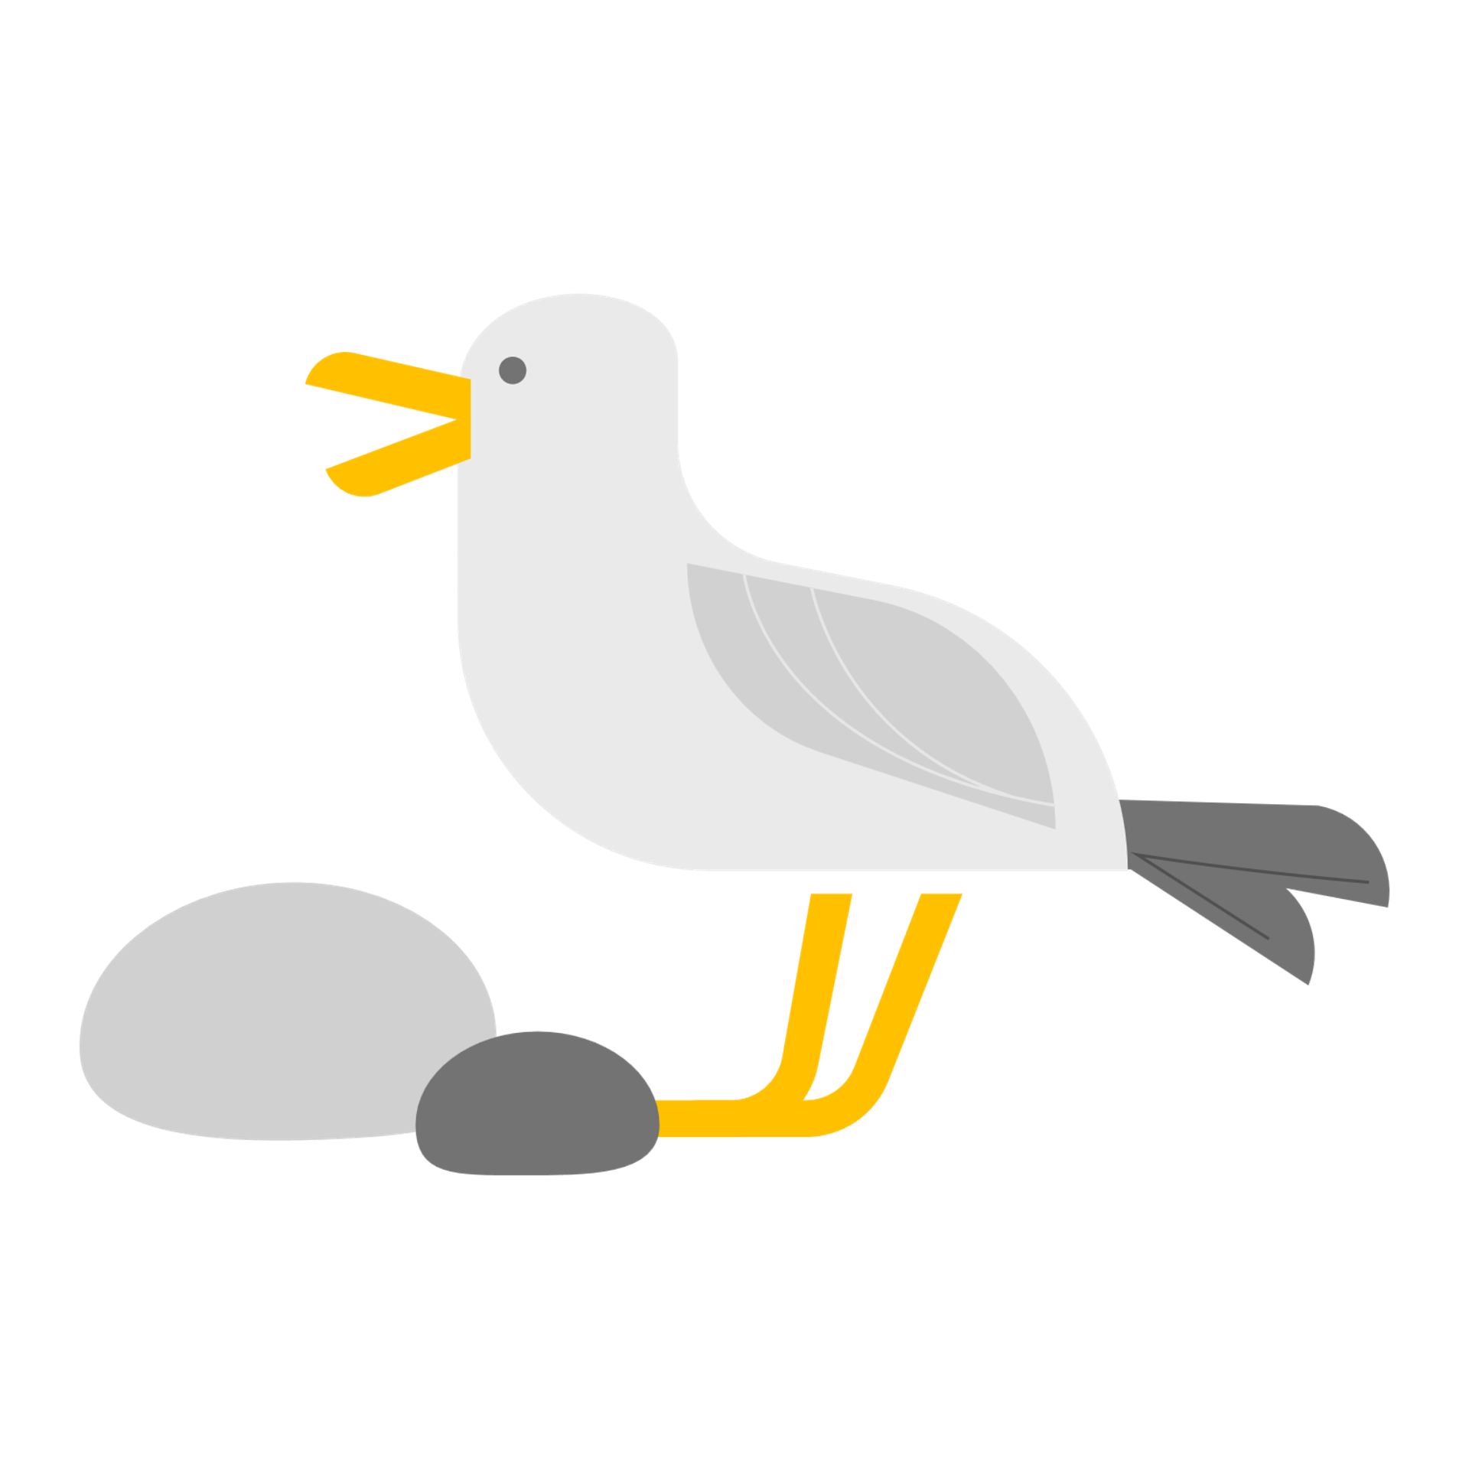
And a big “Thank You” to our judges!
Sam Fried, Chris Fisher, Julian Hough

